Slide 1
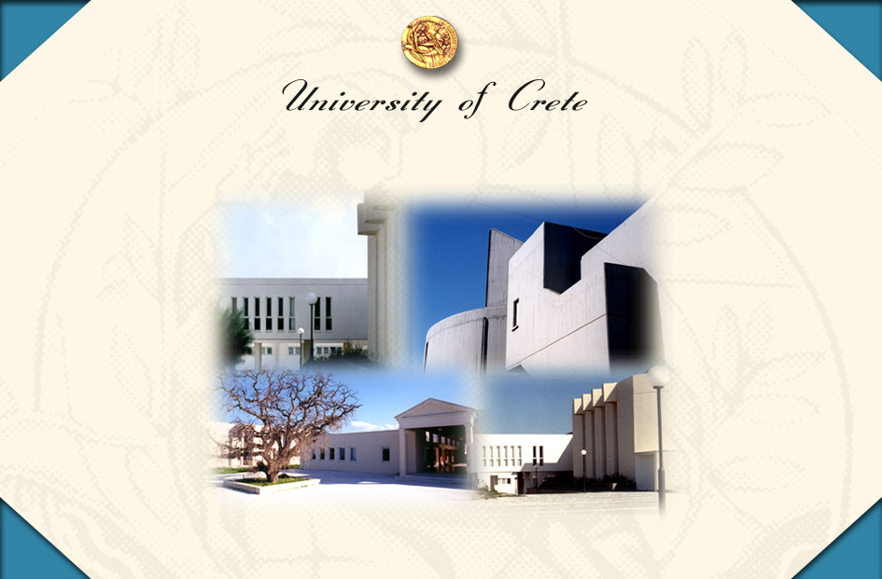

University of Crete
Notes:
Δ 2

Slide 2
Milestones
1973
DECRET OF FOUNDATION OF THE UoC IN RETHYMNON (HEADQUARTERS) AND HERAKLION
1977
INAUGURATION YEAR: FACULTIES OF PHILOSOPHY (RETHYMNON) AND SCIENCES (HERAKLION)
1987
1ST SENAT AND RECTORATE OF UoC
1998
1ST CAMPUS OF UoC IN RETHYMNON
1991-2012
CAMPUS OF UoC IN HERAKLION
Notes:
Δ 2

Slide 3
WHY CREATE A NEW UNIVERSITY IN THE SOUTHEST PERIFERY OF GREECE (AND EUROPE)?
UNIVERSITIES IN ATHENS, THESSALONIKI, PATRAS AND IOANNINA
REGIONAL ECONOMIC STRATEGY – NEED FOR NEW HEIs
POLITICAL PRESSURE OF A REGION TO CENTRAL ADMINISTRATION
NEEDS OF THE GREEK SOCIETY THE UNIVERSITY OF CRETE AMBITIONED TO FULFIL:
ESTABLISHMENT OF A MODERN UNIVERSITY OUTSIDE THE TRADITIONAL CONSTRAINTS OF GREEK ACADEMIA
RECRUITMENT OF YOUNG FACULTY ACTIVE IN RESEARCH MOSTLY FROM THE DIASPORA (USA AND W. EUROPE)
TO ATTRACT EXTERNAL RESEARCH FUNDING ESPECIALLY FROM INTERNATIONAL AGENCIES

Slide 4
STRATEGY TO FULFIL THE GOALS:
I) HUMAN RESOURCES
To invite inspired internationally established scientists of Greek origin employed in recognized institutions ( U.S mainly) having the ambition to create in Crete a HEI following the example of successful Institutions.
F. Kafatos, Harvard University-Biology (Head of the EMBL – Heidelberg and initiator and Director of ERC).
D. Tsichritzis, Univ. of Toronto-Computer Sciences (University of Geneva, Head the German Research Centre for Information Technology).
G. Sifakis, University of New York.
E. N. Economou, University of Virginia-Physics.
P. Lambropoulos, University of S. California-LASER Physics.

Slide 5
II) TO CREATE A “NEW MODEL” FOR GREEK HIGHER EDUCATION
The New University Law (Shift from the “German” to the “American” Model; 1982) offered more independence (and responsibility) to young scientists to follow their own ideas of research.
New Departments and scientific disciplines were established for the first time in Greece (Computer Science, Molecular Biology and Biotechnology, LASER Physics, Environmental Sciences).
For the first time postgraduate studies were created (courses, exams, qualifying exams, proposal, etc.) in Greece. Young graduates from other Greek Universities came to Crete for postgraduate studies. The “UoC Model” served to establish a law for Postgraduate studies in Greece (1993).
A new Model (for Greece) of Institutional Teaching/Research Relationships and Structures was followed:

Slide 6
Establishment of independent (from the University Administration) Research Centres:
The Foundation for Research and Technology – Hellas:
Institutes of Molecular Biology and Biotechnology, Electronic Structure and LASER, Computer Sciences, Applied Mathematics and Mediterranean Studies.
The Institute of Marine Biology of Crete
The Institutes were funded (e.g. equipment, travel grants and consumables) for research from the Ministry of Development (starting money for young researchers)
ADVANTAGES CREATED:
Despite the distance from decisions centers (Athens), teaching at the University and working as Researchers in the Institutes implied:
    No need to start from zero (equipment to help grant hunting), good research infrastructure and environment, salary increase.

Slide 7
OUTCOME:
The University of Crete earned the reputation (very soon) of the HEI in Greece “where research is possible”. The University of Crete offered a challenge to young Greeks serving other Institutions abroad, with impressive records of research publications, to continue their scientific career in Greece.

Slide 8
1977
Administration by a 5-member Appointed COMMITTEE
Two Departments (Mathematics & Philology)
Ca. 10 faculty members
Hosted in secondary school buildings – lack of its own PREMISES

Slide 9

TODAY (35 YEARS AFTER)
Rethymnon
Administrative Headquarters
Faculty of Philosophy (3 Depts.)
Faculty of Social Sciences (4 Depts.)
Faculty of Education (2 Depts.)
Heraklion
Faculty of Sciences and Engineering (7 Depts.)
Faculty of Health Sciences
•
•
Gallos
○
○
Voutes

Slide 10
Human Resources (2010-2011)
Rethymnon:
207 Faculty Members
8433 UG-Students
691 G-Students
313 D-Students
41 UG-S/F
3 G-S/F
Heraklion:
300 Faculty Members
5977 UG-Students
544 G-Students
978 D-Students
20 UG-S/F
2 G-S/F
14410
1235
1291
Undergraduate
Students
Μgraduate
Students
Doctoral
Students
507
Faculty Members
55
Teaching Supporting Personnel
73
Teaching Associates
451
Administrative and
Technical Personnel

Slide 11
Gender Situation
41% M
59% F
40% M
60% F
55% M
45% F
UG-S
G-S
D-S
73% M – 27% F
FM
29% M – 71% F
TSP
60% M – 40% F
TA
36% M – 64% F
ATP

Slide 12
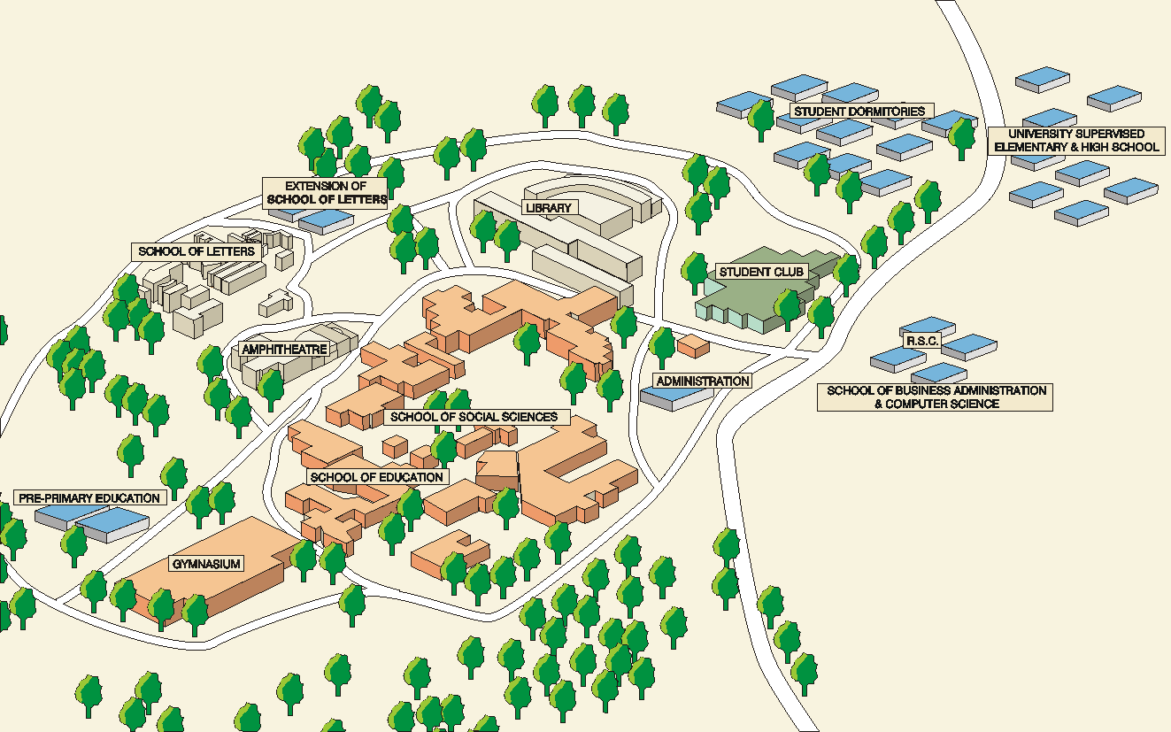
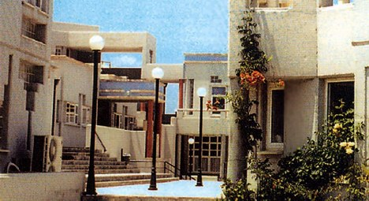
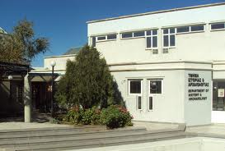
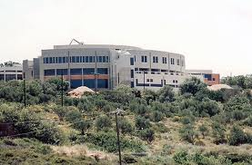
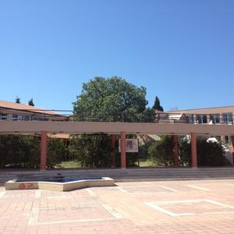

Rethymnon Campus

Slide 13
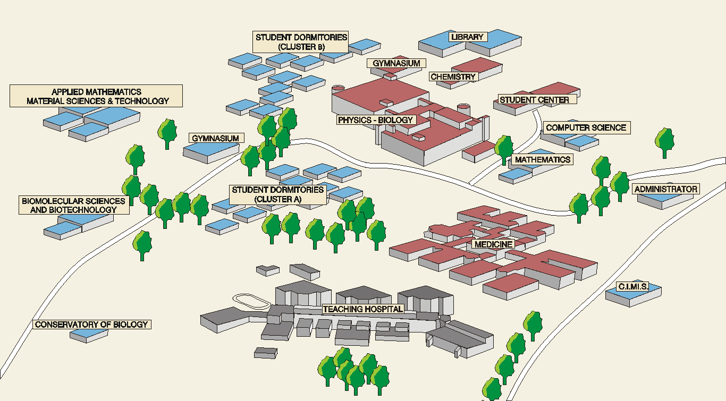
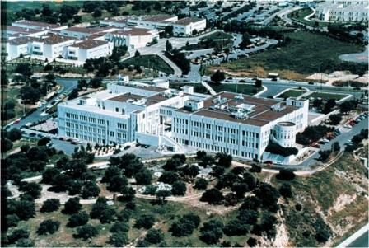
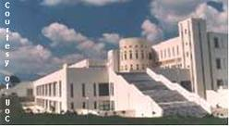
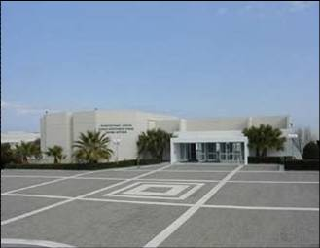
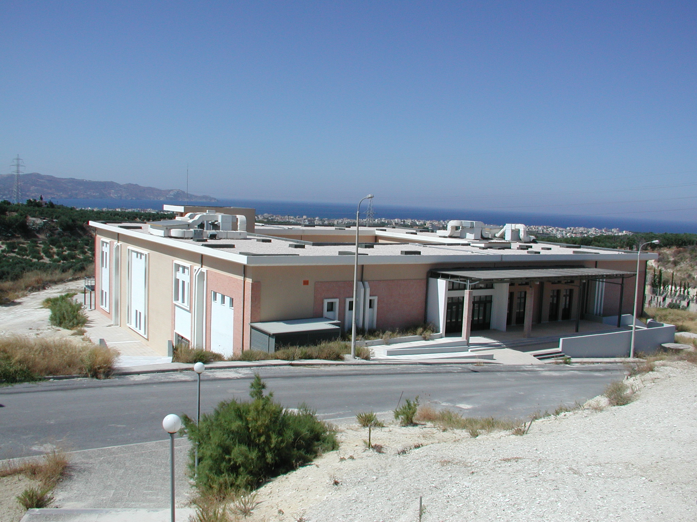
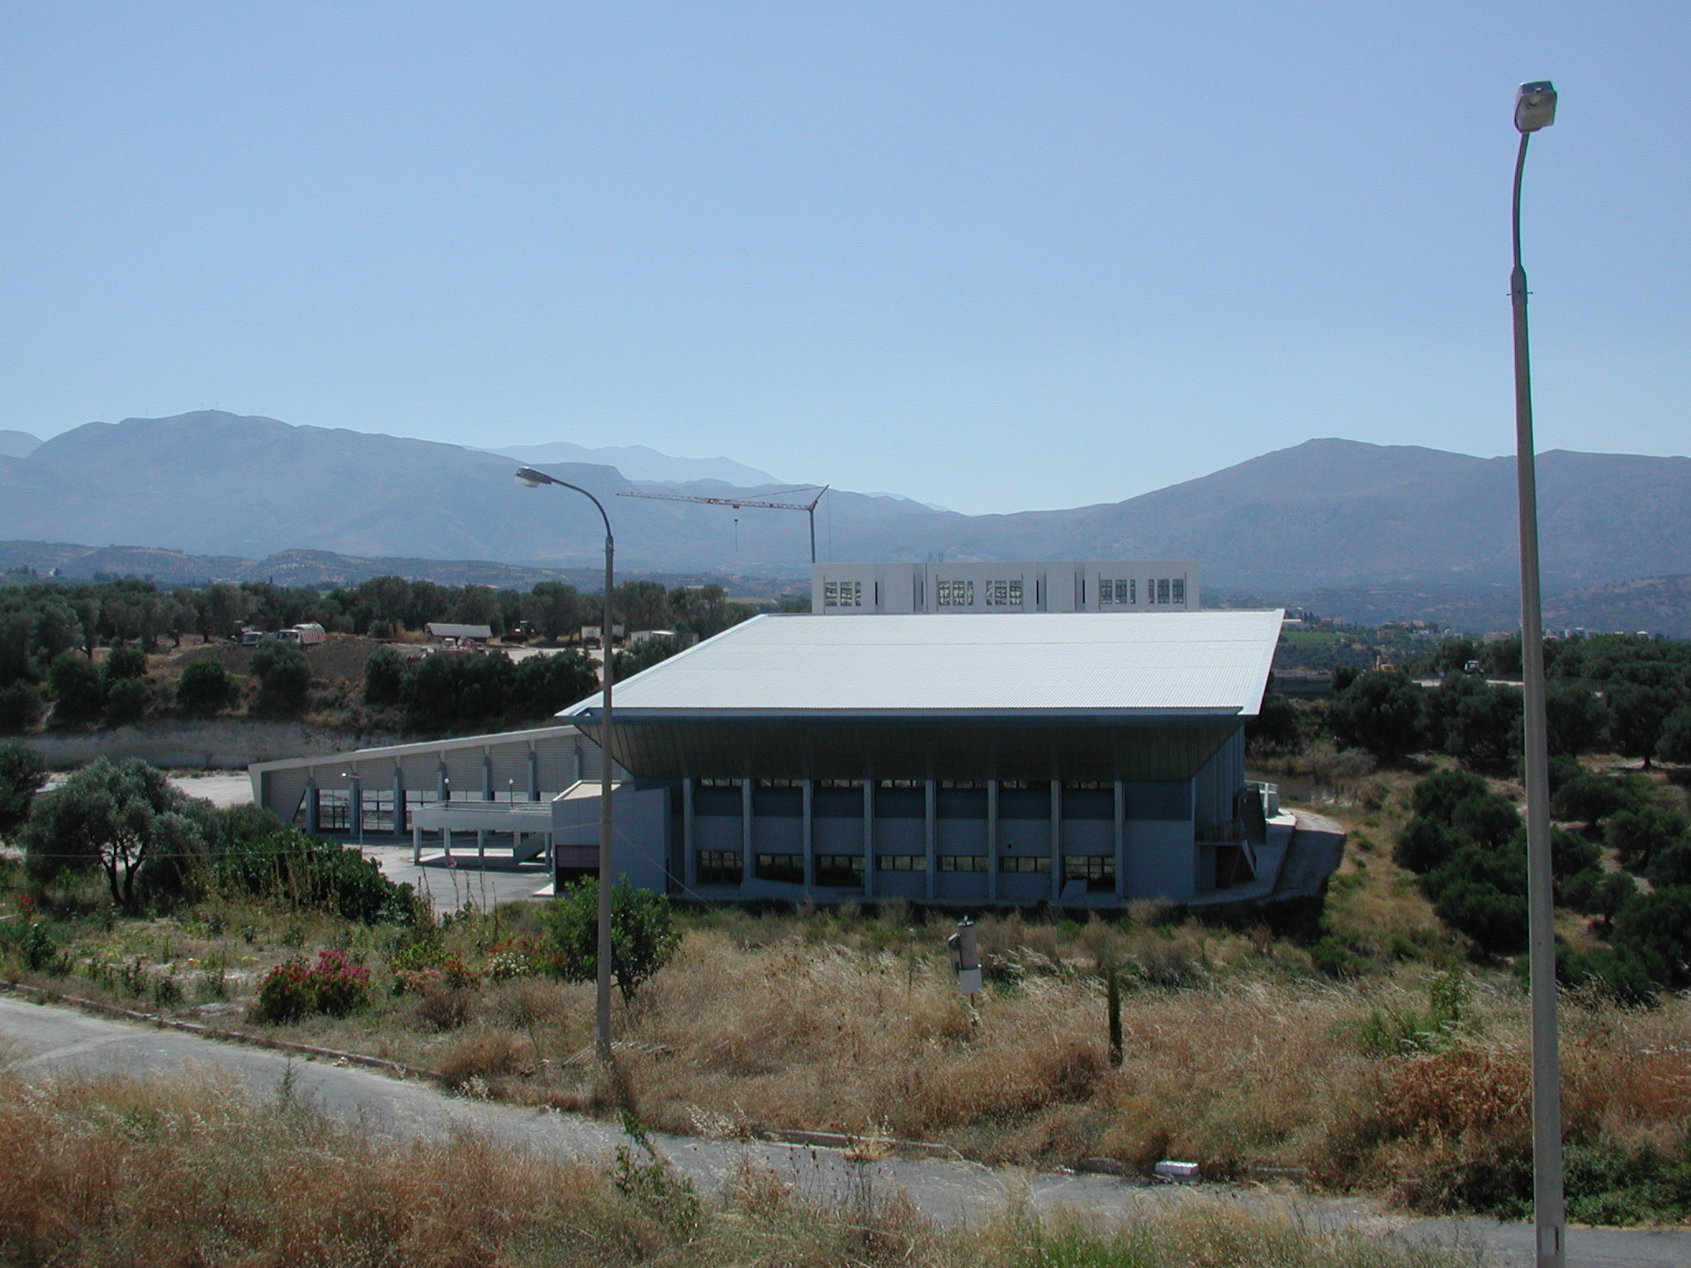
Heraklion Campus

Slide 14
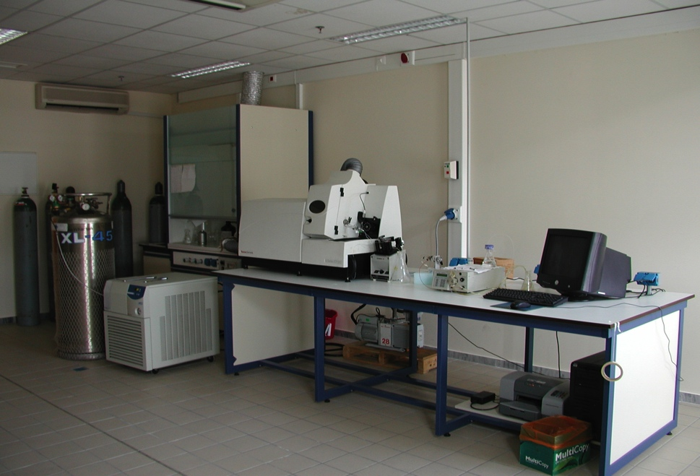
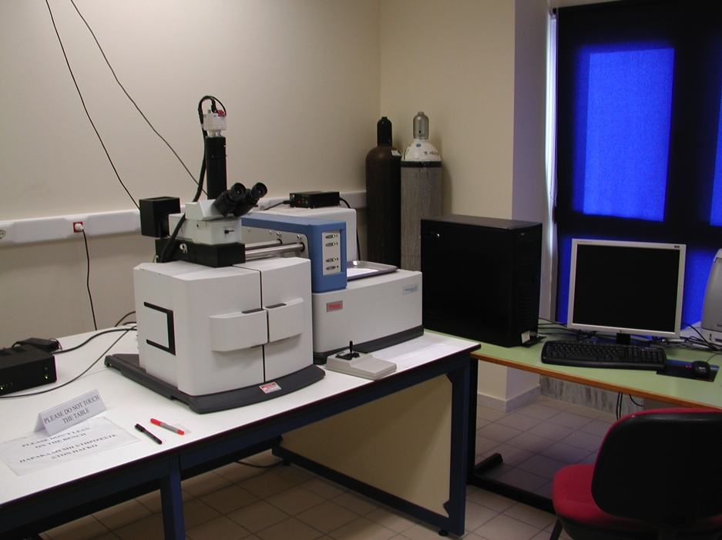
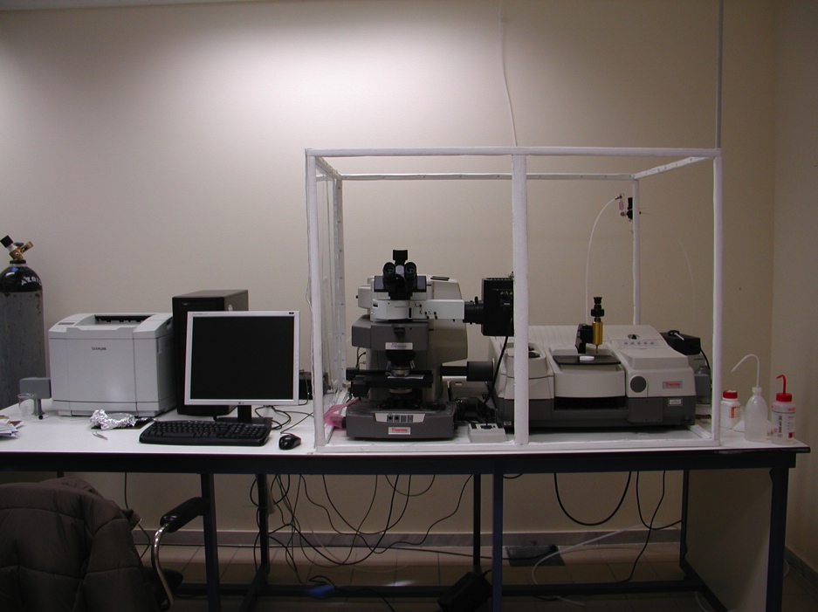
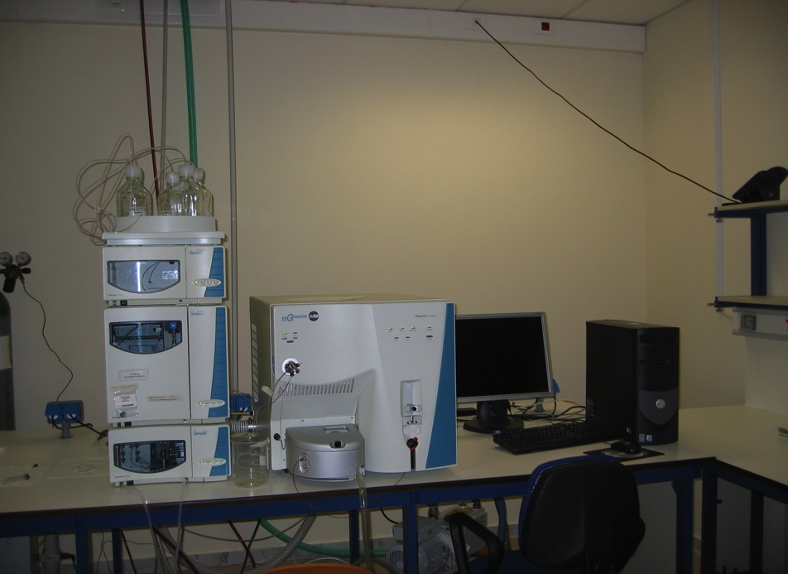
ICP-MS Thermo Elemental X series
Raman Microscope
LC-MS: Finnigan TSQ
FT-IR Microscope

Slide 15

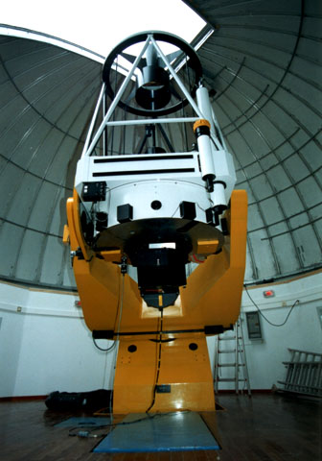
SKINAKA’s OBSERVATORY (Psiloritis Mountain)

Slide 16
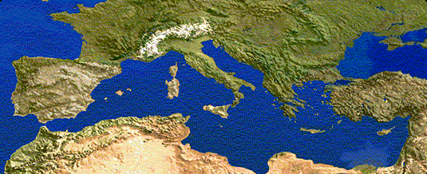
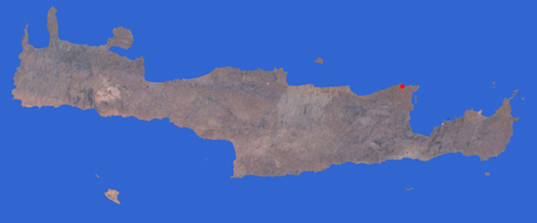
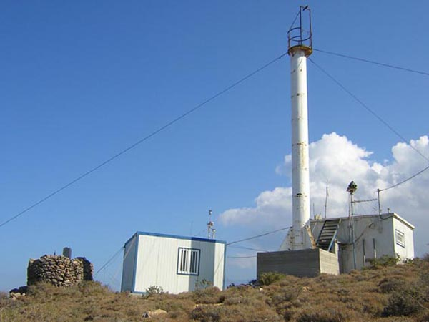
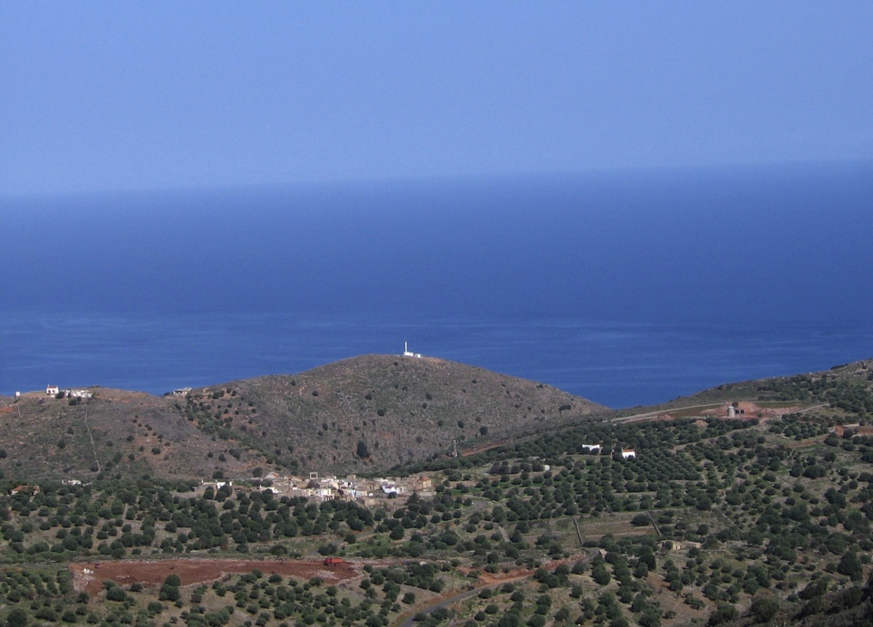
FINOKALIA ATMOSPHERIC RESEARCH STATION
http://finokalia.chemistry.uoc.gr
Heraklion

Slide 17

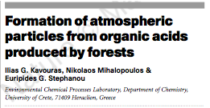

SCOPUS: 280 citations
Forest emission/aerosol link quantified
Photooxidation of the hydrocarbons emitted by forest produces large quantities of organic aerosol that could significantly influence climate and some atmospheric chemical processes, according to chemists at the University of Crete, Greece [Nature, 395, 683 (1998)]. Professor of environmental organic chemistry Euripides G. Stephanou, assistant professor of atmospheric chemistry Nikolaos Mihalopoulos, and Ph.D. student Ilias G. Kavouras collected air samples from a 20-meter-high sampling tower in the middle of an eucalyptus forest in Portugal.
Using a variety of analytical techniques, they simultaneously measured concentrations of ozone, nitrogen oxides, nonmethane hydrocarbons such as terpenes, and fine aerosols. Analysis of the data showed that hydrocarbons emitted by the trees are photooxidized to organic acids such as pinonic acids, which condense to form organic aerosols. These aerosols act as cloud condensation nuclei, the team suggests. "This work is original because it was conducted in a forest atmosphere and not in a reaction chamber", Stephanou tells C&EN. "It provides evidence for the first time, of a quantitavite link between non-methane hydrocarbon emission by vegetation and organic aerosol formation."

Slide 18
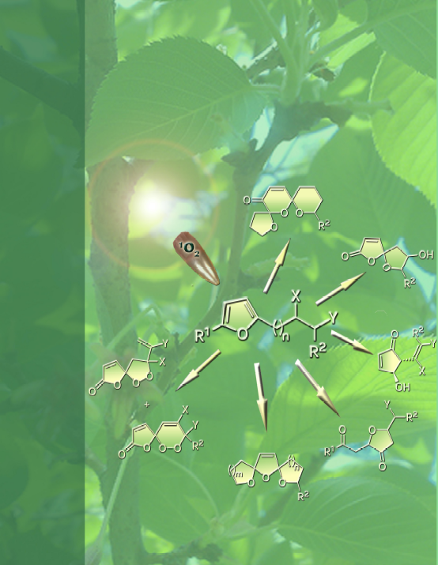

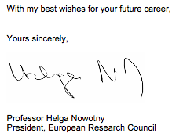
Assoc. Prof. George Vassilikogiannakis
Advancing the Green Chemistry of Singlet Oxygen and Applying
it to Synthetic Challenges

Slide 19
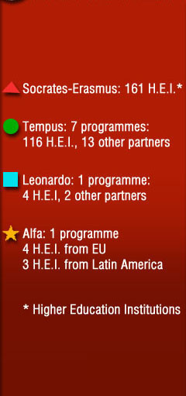
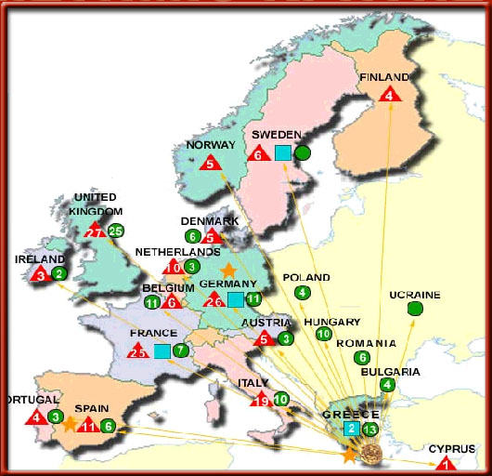
ERASMUS PROGRAMME: “A SUCCES STORY FOR UoC”

Slide 20
EVALUATIONS and RANKINGS
‘Not everything that counts can be counted, and not everything that can be counted counts’
A. Einstein

Slide 21
EVALUATION OF UoC
Self-promoted evaluations
1st Evaluation1999
Helen Arveler (Sorbonne), Amadeo Odoni (MΙT), Maurice Aymar (Ecole des Hautes Etude en Sciences Sociales), Stelios Argyros (European Parliament), Nikos Mouzelis (London School of Economics).
2nd Evaluation 2001
CRE-European University Association

Slide 22

Physics
Medical School
Biology
History- Archaeology
Chemistry
Material Science and Engineering
Mathematics
Applied Mathematics
Computer Science

Slide 24
Research Image of UoC among the other Greek HEIs
1993-2008

Slide 25
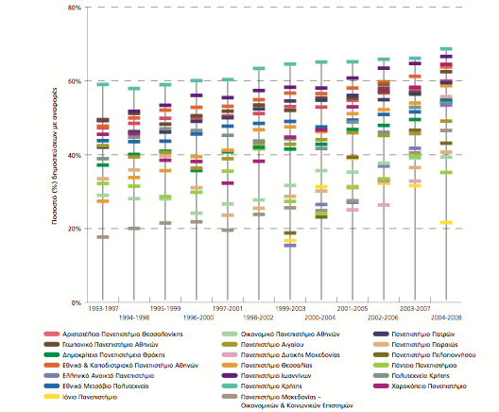
Publications cited/Total Nr. of Publications
75%
60%

Slide 26
Publication Impact
UoC is above the world average for the categories top 1%, 5%, 10% & 25%.

Slide 27
1999-2009 Total Citations (TC)
PROFESSOR | CITATIONS
Prof A | 1672
Prof B | 1302
Prof C | 1334
Prof D | 874
1999-2009 TC – self C
PROFESSOR | CITATIONS
Prof A | 1456
Prof B | 1127
Prof C | 1206
Prof D | 779
Average | 1142

Slide 28
Impact of Publications in different disciplines

Slide 29
Leiden Ranking
Leiden Ranking 2011/2012-EUROPE (publications in English): the 400 largest
All languages: 123
All languages: 292
Leiden Ranking 2011/2012-WORLD(publications in English): All
Leiden Ranking 2011/2012-GREECE
320 Kyoto Univ 14941 9.5%
321 Univ Torino 4448 9.5%
322 Natl Chiao Tung Univ 4473 9.5%
323 Politecnico Milano 2743 9.5%
324 Univ Crete 1955 9.5%
325 Univ Burgundy 1685 9.5%

Slide 30

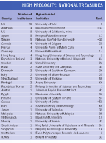
HIGH PRECOCITY: NATIONAL TREASURES
http://www.timeshighereducation.co.uk/story.asp?storycode=419908
http://europe.nxtbook.com/nxteu/tsl/100under50/index.php#/0
UNIVERSITY OF CRETE
RANKED 50th AMONG THE 100 BEST

Slide 31
RESEARCH & CITATION IMPACT
SCHOLARLY PAPERS/ACADEMIC STAFF
CITATION IMPACT

Slide 32
"HR Excellence in Research"
"Comments from the three assessors:
The process of consultation with all areas of the University is particularly commendable, acting as it does as a 'reality check' ensuring that all relevant issues have been examined.
Acknowledgement / general comments
A real and serious work of analysis has been made. A number of valuable initiatives are announced, particularly in fields such as recruitment, working environment....
...Therefore, the University of Crete now fulfills all the requirements for the Commission acknowledgement and has the right to use the "HR Excellence in Research" logo. Congratulations!
Denis CLARKE
Assistant Policy Officer
European Commission
DG Research & Innovation
B2

Slide 33
UoC in the time of crises ???
Human Resources / Equipment – Infrastructures / “Strategic Alliances”
Interdisciplinary cooperation within UoC
Cooperation: International and National
Creation of Interdisciplinary Centres of Excellence
Continuous effort to attract young outstanding academics and graduate students
Cooperation with the private sector to promote research outcome of UoC

