Slide 1
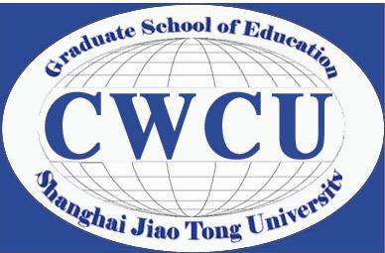
Career Structure and Challenges for Young Faculty at Chinese Research Universities
Qi Wang
Center for World-Class Universities
Graduate School of Education
Shanghai Jiao Tong University

Slide 2
Chinese Higher Education Development
The unprecedented expansion has mad China the largest higher education system in the world: - increasing higher education institutions; - increasing student enrolment.
Figure 1. Higher education student enrolment (2000-2010)
Source: Educational Statistics Yearbook of China, 2000-2010 (Ministry of Education 2012b).

Slide 3
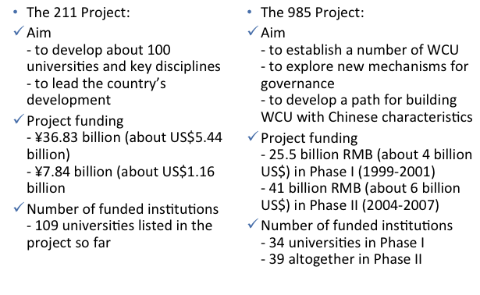
Research Universities in China (1)

Slide 4
Research Universities in China (2)
The impact of national initiatives: - Creating a culture of excellence; - Attracting elite talents; - Enhancing teaching and research quality; - Strengthening the status of research universities.
Research universities’ leading status: - Reform model; - Better resource; - More opportunities.

Slide 5
University Faculty Development (1)
To serve ever-increasing student demand, the university faculty size and its quality has been raised.
Table 1. The change of university full-time faculty (thousand)
Year | Number of university faculty | Number of young faculty (under 35) | Number of newly recruited faculty | Percentage of young faculty (under 35)
2000 | 462.77 | 220.23 | 68.16 | 47.59%
2001 | 531.91 | 247.01 | 91.84 | 46.44%
2002 | 618.42 | 285.92 | 112.74 | 46.23%
2003 | 724.66 | 340.85 | 134.86 | 47.04%
2004 | 858.39 | 405.73 | 162.26 | 47.27%
2005 | 965.84 | 463.91 | 149.50 | 48.03%
2006 | 1075.99 | 520.13 | 152.88 | 48.34%
2007 | 1168.30 | 566.81 | 139.85 | 48.52%
2008 | 1237.45 | 591.26 | 115.76 | 47.78%
2009 | 1295.25 | 608.93 | 102.20 | 47.01%
2010 | 1343.13 | 620.75 | 98.44 | 46.22%
Source: Educational Statistics Yearbook of China, 2000-2010 (Ministry of Education 2012b).

Slide 6
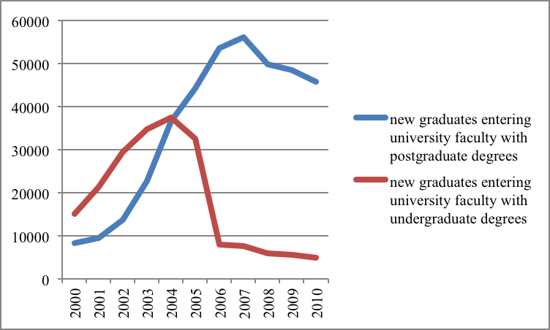
University Faculty Development (2)
Young academics have become a major force for higher education development in China.
Figure 2. New graduates entering university faculty positions (2000-2010)
Source: Educational Statistics Yearbook of China, 2000-2010 (Ministry of Education 2012b).

Slide 7
Career Paths and Employment Reform (1)
The academic post system: a four-rank hierarchy.
Employment reform has been implemented since early 2000s: - A new rank system parallels the traditional post system;
Professor
Professor (Rank 1, 2, 3 and 4)
Associate Professor
Associate Professor (Rank 5, 6 and 7)
Assistant Professor
Assistant Professor (Rank 8, 9 and 10)
Teaching Assistant
Teaching Assistant (Rank 11, 12 and 13)

Slide 8
Career Paths and Employment Reform (2)
The academic post system: a four-rank hierarchy.
Employment reform has been implemented since early 2000s: - A new ranking system parallels the traditional post system; - Three main categories include research-track, teaching-track and research-teaching combined; - This post and contract-based system is considered as a reflection of the academic profession change from a predominantly bureaucratic to a competitive corporate culture in China (Chen 2003; Yang 2005; Lai 2012).

Slide 9
Current State of Young Faculty in Research Universities
Research show: - Young faculty are in general satisfied with their current work and position; - Academic posts are considered as higher status in terms of reputation and social respects; - Academics feel positive on working conditions; - In turn, young faculty are generally committed to their profession. (Zhu and Zhuo 2005; Li 2008; Liu 2009; Yan 2011; Guo 2012)
Challenges: - Teaching (such as heavy teaching load, lack of systematic teacher training); - Research (such as limited research opportunities, employment reform impact on publication); - Life and work quality (low salary but high living cost). (Chen 2003; Qian 2005; Zhang 2008; Yang 2009; Yang, Ma and Zhuang 2010; Yan 2011)
In summary, young faculty members are at a relatively disadvantaged position in the Chinese academia.

Slide 10
Strategies and New Practices
To keep improving working conditions and provide adequate financial support.
To provide systematic on-the-job training services.
To fully support young academics’ research ideas and innovation.

Slide 11
Thank you!

