Slide 1
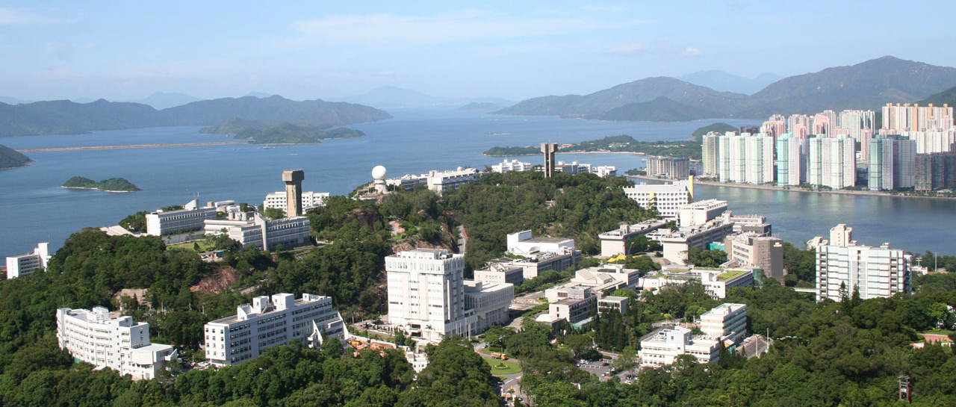

Paths to Academic Excellence
The Chinese University of Hong Kong

Slide 2
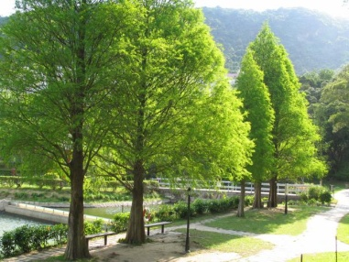
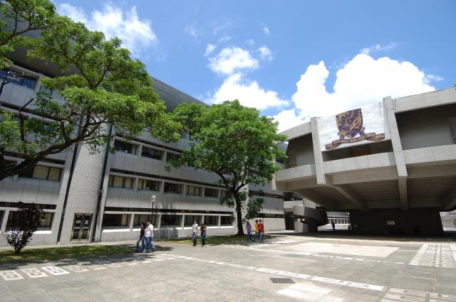
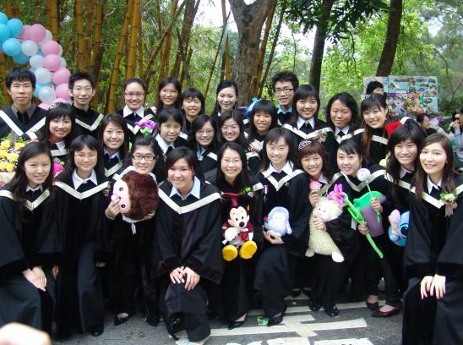
CUHK History
Background
Founded in 1963
Student population
  >15,000 undergraduates
  >12,000 postgraduates
Teaching and Research Staff: > 3,000
Alumni: >126,000

Slide 3
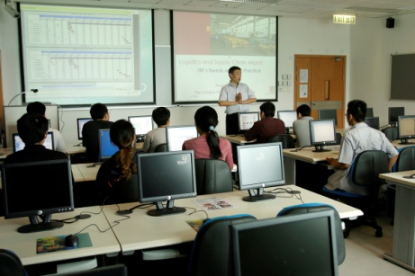
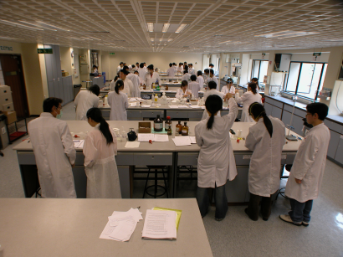
CUHK Characteristics
Comprehensive research university
Chinese & humanistic heritage
International character & bilingual traditions
College system
General and whole-person education
Notes:
3
Source: Former VC Lau’s ppt; PVC Cheng’s ppt; VC’s Installation Speech (3rd bullet point)

Slide 4

Bicultural & Bilingual Traditions
Bicultural emphasis
“To combine tradition with modernity, to bring together China and the West”
Bilingual policy
Undergraduate: 60% in English
Postgraduate: ~85% in English
Notes:
4
Source: Former VC Li; Former VC Lau’s ppt; SCLE website

Slide 5
Humanistic Tradition
Science/Technology + Humanities/SocSci
Sensitivity to human needs
Appreciation of arts
Imagination, creativity and critical thinking

Slide 6
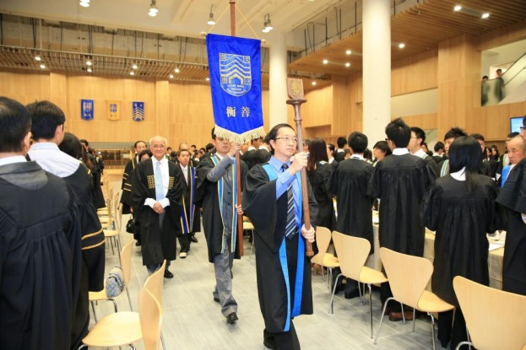
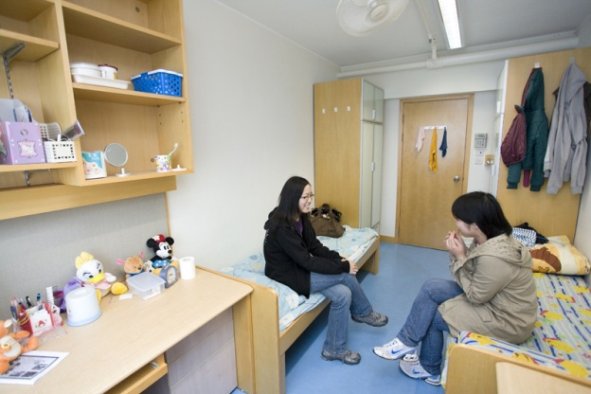
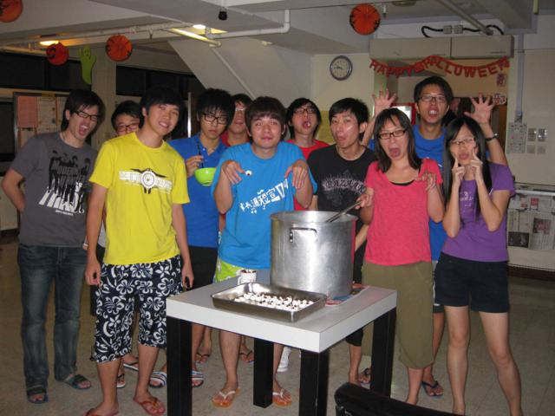
College System
Unique to HK & Asia
Congenial communities (residential halls, culture and spirit)
Pastoral care
Whole-person education via non-formal learning opportunities

Slide 7
Paths to Academic Excellence

Slide 8
Gateway to China
  Universities Service Centre for China Studies
  Established in 1963, one of the world’s most extensive collection on contemporary China, attracting scholars from around the world to pay annual pilgrimage
  Yale-China Association
  Affiliation with CUHK’s New Asia College since 1954
  Promote understanding between Chinese & Americans through programmes in the arts, education, health, and public service across China

Slide 9

Gateway to China
Institute of Chinese Studies
HK Government Area of Excellence project “Historical Anthropology of Chinese Society”
New Contemporary China Studies programme
  Membership in the Worldwide Universities Network

Slide 10





Research Focus
5 Major Focused Areas
Chinese Studies
Biomedical Sciences
Information Sciences
Economics & Finance
Geoinformation & Earth Sciences

Slide 11
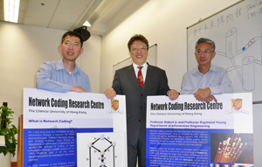
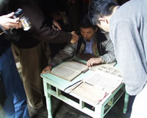

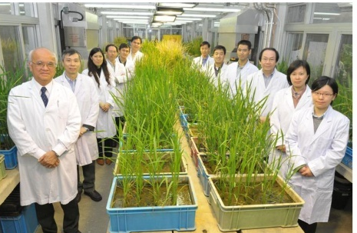
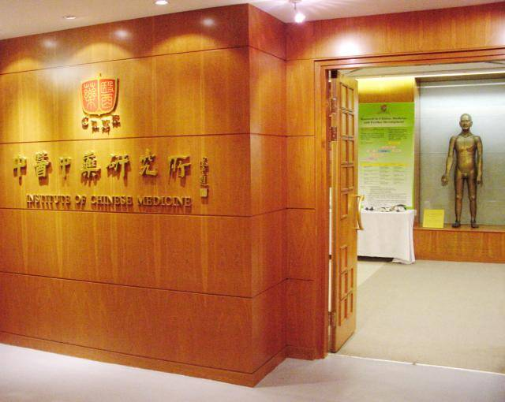
Research Focus
HK Government Area of Excellence Programme
- CUHK leads 6 out of 15
Network Coding
Historical Anthropology of Chinese Society
Circulating Fetal Nucleic Acids
Plant and Agricultural Biotechnology
Chinese Medicine Research
Information Technology

Slide 12
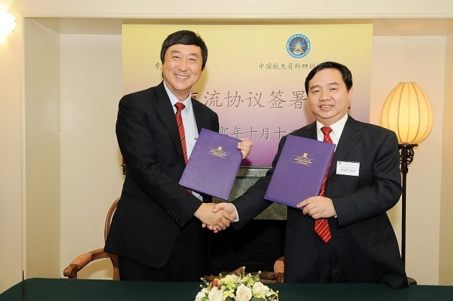
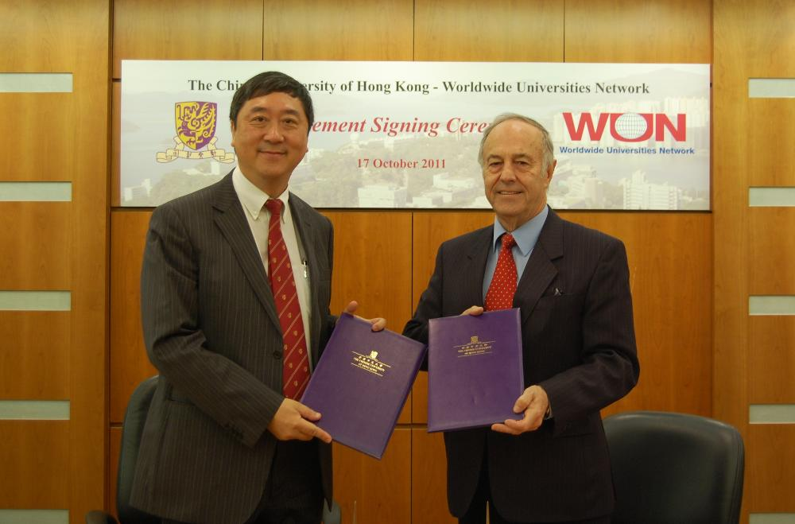
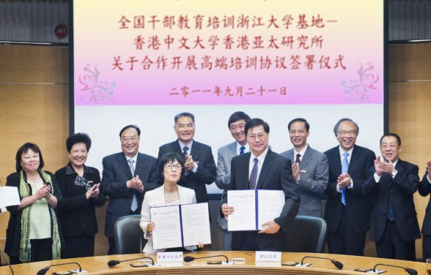
Research Focus
International & Mainland Collaborations
Currently 150+ formal institutional research collaborations with overseas institutions
110+ with institutions in Mainland and Taiwan
  Over 30 joint research centres & laboratories

Slide 13
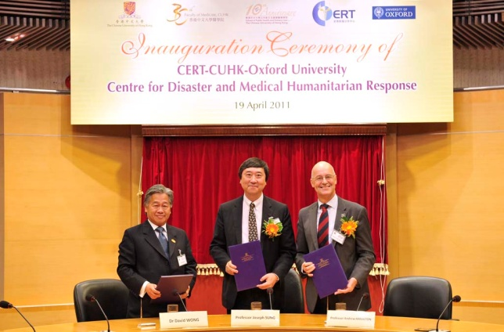
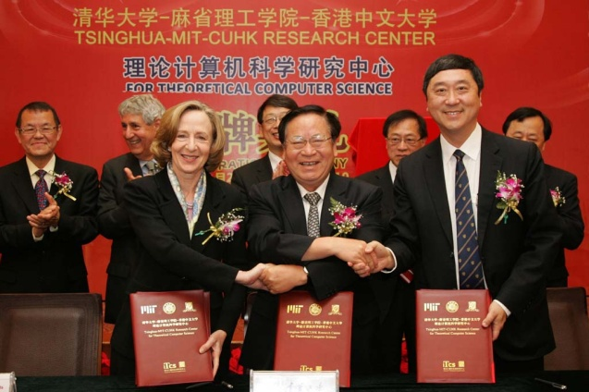
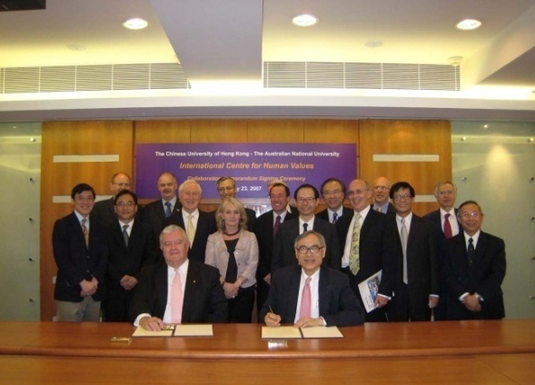
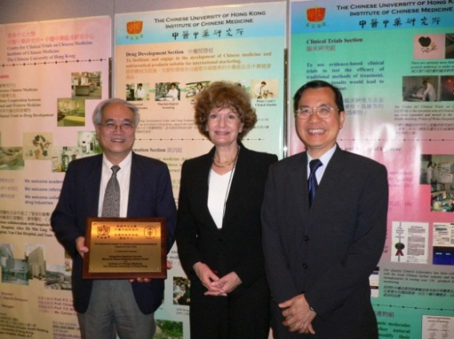
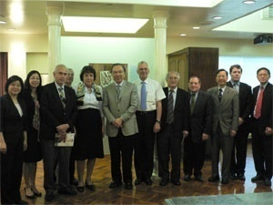
Research Focus
Collaborating Centre for Oxford University & CUHK for Disaster & Medical Humanitarian Response
Tsinghua – MIT – CUHK Research Centre for Theoretical Computer Science
Australian National University: Research Centre for Human Values
Memorial Sloan-Kettering Cancer Centre, USA: International Collaborative Research Centre for Botanical Immunomodulators
CNRS and ENSCP, France: Joint Laboratory of Molecules from Traditional Medicine

Slide 14
Research Focus
State Key Laboratory (SKL)
Est. in 1984 by the Ministry of Science & Technology of China to enable the country’s most accomplished scientists & scholars to conduct pioneering research to further support China’s technological & economic development
4 SKLs at CUHK - statement of national recognition
  SKL in Oncology in South China
  SKL of Agrobiotechnology
  SKL of Phytochemistry & Plant Resources in West China
  SKL on Synthetic Chemistry

Slide 15
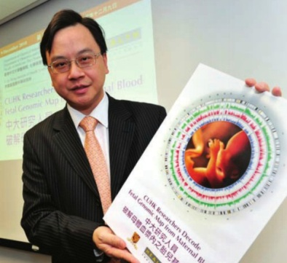
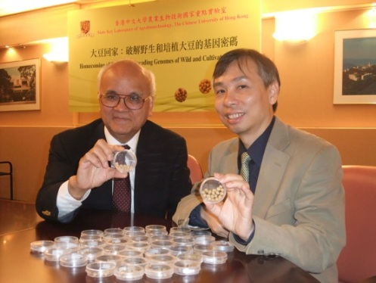
Research Focus
Landmark Achievements
Non-invasive prenatal diagnostic services by Prof Dennis Lo
  Discovery of fetal DNA in the plasma of
  pregnant women
Rice and soybean research with improved agricultural output & nutrition by Prof Samuel Sun
  Bill and Melinda Gates Foundation’s
  Grand Challenges in Global Health
  Grants – “Golden Rice” project

Slide 16
Research Focus
Landmark Achievements
Smallest Bluetooth communication module
Network coding theory
Reconstruction & 3D visualization of the world’s hi-res virtual human 1,700 GByte
Satellite remote-sensing receiving station in
SE Asia (one of only two in China)

Slide 17
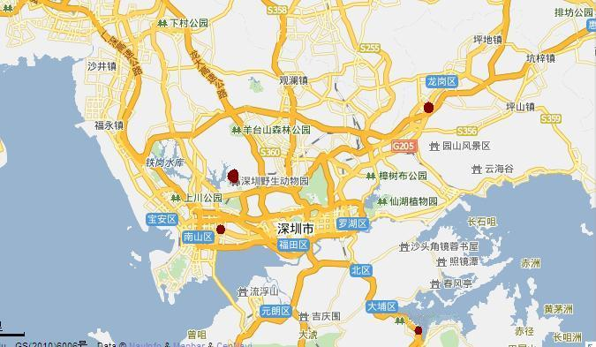
Excellence into China –
Shenzhen Initiative
CUHK(SZ)
SIAT
SZRI
CUHK
Notes:
17

Slide 18

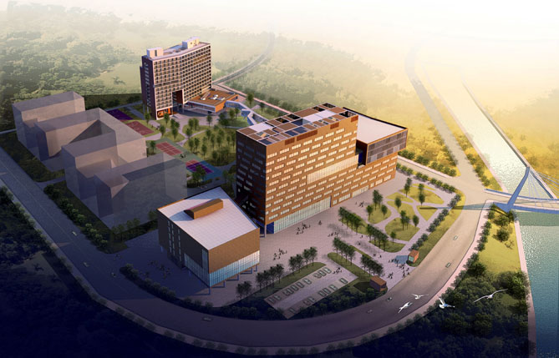
Shenzhen Institute of Advanced Technology
Jointly with CAS and Shenzhen Government (2006)
  First and only national research institute in Shenzhen
  Only national research institute with non-mainland organization
3 Research Institutes:
  Integration Technology Institute
  Biomedical & Health Engineering
  Institute
  Digital & Computing Institute

Slide 19
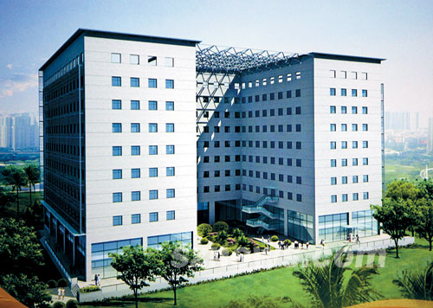
CUHK Shenzhen Research Institute
Opened in Nov 2011
Education & training base
Home for SKL laboratories & important research centres
  Focus Research Areas: Biomedical Sciences; Information Technology; Environment, Energy & Sustainability
Platform for technology transfer

Slide 20

Collaborations with BGI Genomics Institute, Shenzhen
CUHK-BGI Genome Research Centre
  Findings of the project ‘Homecoming of Soybeans’ made cover story in Nature Genetics
CUHK-BGI Innovation Institute of Trans-omics
Clinical Genomics Collaboration

Slide 21

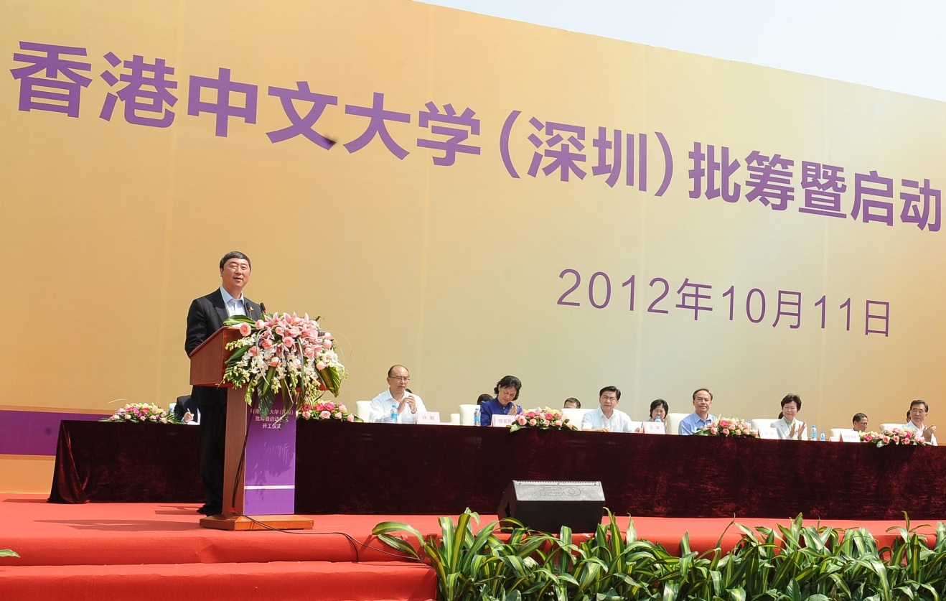
CUHK (Shenzhen) in collaboration with Shenzhen University. First students in 2013

Slide 22
Teaching Excellence
4 |  | Nobel Laureates
1 |  | Fields Medalist & Wolf Prize Laureate in Mathematics
1 |  | Turing Award Winner
2 |  | Fellows of the Royal Society
1 |  | Fellow of the Royal Society of Edinburgh
10 |  | Academicians of the Chinese Academy of Sciences
3 |  | Academicians of the Chinese Academy of Engineering
8 |  | Academicians of Academia Sinica
15 |  | State Natural Science Awards
15 |  | Awardees of the Croucher Senior Research Fellowship
6 |  | Awardees of the Croucher Senior Medical Research Fellowship
28 |  | IEEE Fellows
2 |  | Members of the US National Academy of Engineering
6 |  | Fellows of the American Physical Society
2 |  | Fellows of the Econometric Society
3 |  | Winners of Cheung Kong Achievement Award
11 |  | Ministry of Education Higher Education Outstanding Scientific Research Output Awards

Slide 23
Educating Global Citizens
General & Whole-person Education
Tradition of general education since inception
Student exchanges started in 1965
100% exchange in 4-year curriculum
Global Internship Programme
Graduates with critical mind, global outlook, and civic responsibility

Slide 24

Educating Global Citizens
Admitting Top Students – Local
Largest share of first-choice local applicants
JUPAS (HKALE) – 3-year curriculum
JUPAS (HKDSE) – 4-year curriculum

Slide 25
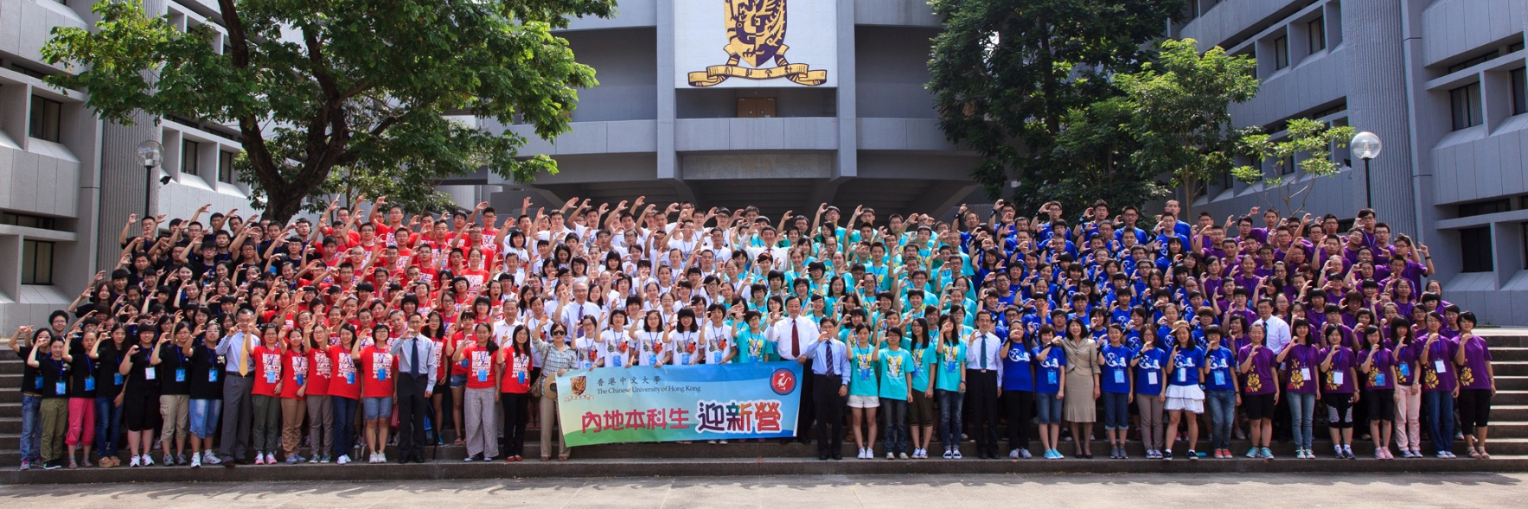
Educating Global Citizens
Admitting Top Students - Mainland
National Colleges & Universities Enrolment System
  305 admitted from 31 provinces and municipalities in 2012
Top scorers in 28 provinces/cities
In the provinces/cities with ranking
  49 rank among the top 3
  97% within top 500

Slide 26
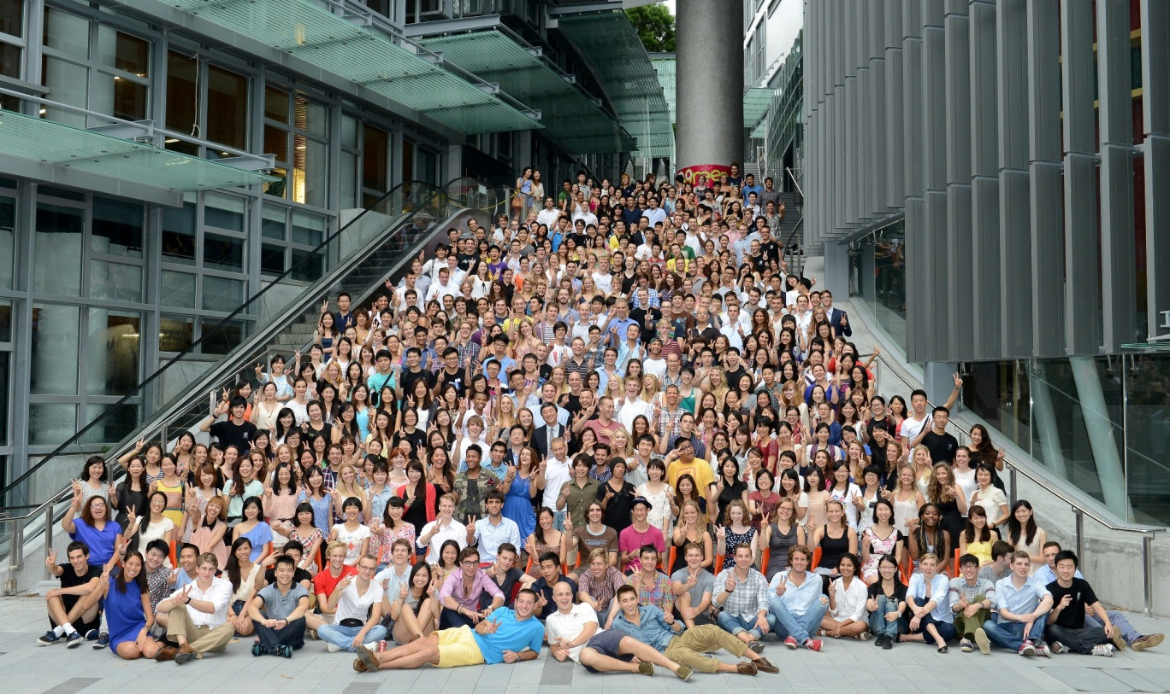
Educating Global Citizens
Admitting International Students
> 500 international students admitted in 2012 (Australia, Austria, Bulgaria, Cambodia, Canada, Germany, India, Korea, Malaysia, Netherlands, Nigeria, Russia, Singapore, South Africa, Switzerland, UK and USA)

Slide 27
Student Exchange
Over 230 universities in 29 countries/regions

Slide 28

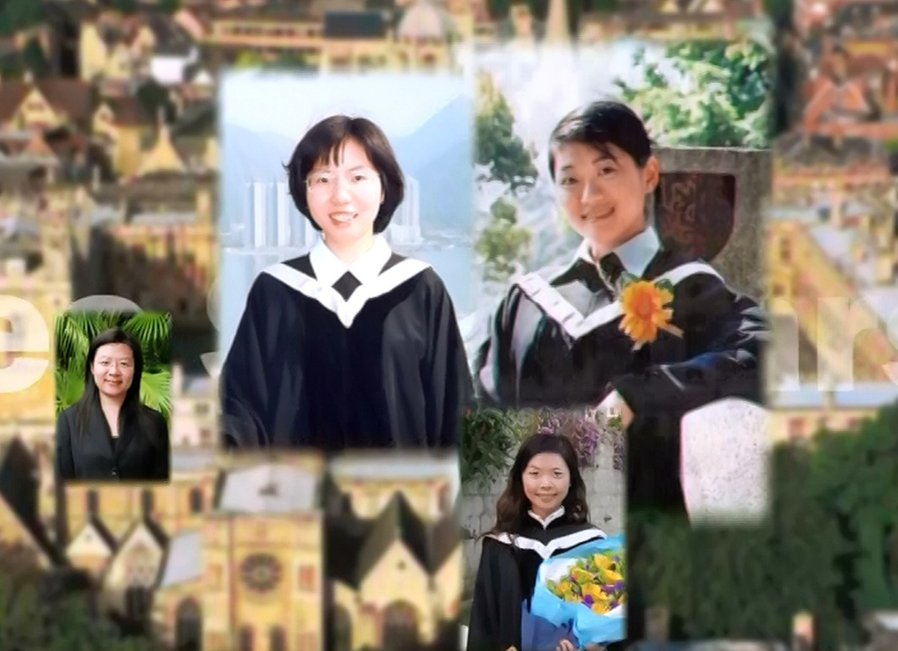
Outstanding Students as World Citizens
Rhodes Scholars – 13 elected to Oxford for further studies since 1985, the university with the most Rhodes Scholars in HK

Slide 29


I*CARE
Cultivate humanistic spirit & enhance social awareness
Social & civic engagement programmes
  Service projects & action-research projects
  Internships in NGOs
  Social enterprises & corporate social responsibility projects
  University lectures on civility, seminars & forums
  Enhancement of students’ mental wellness

Slide 30
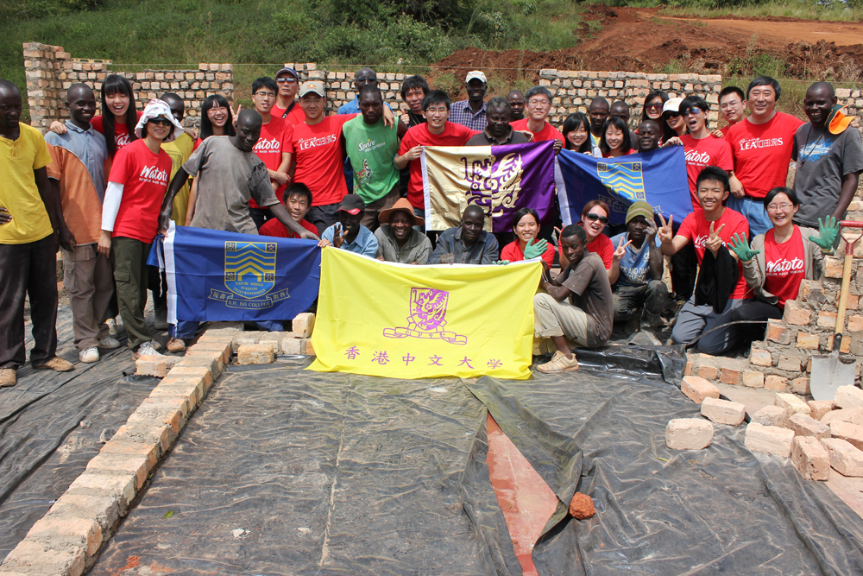
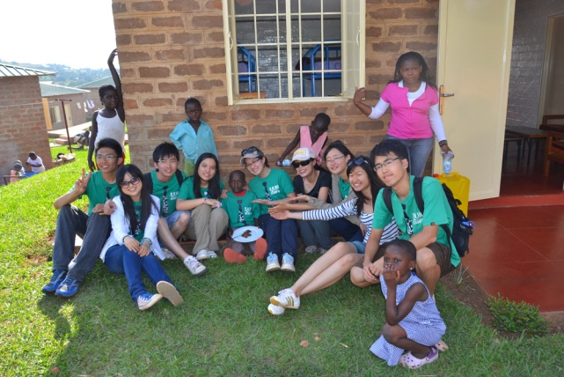
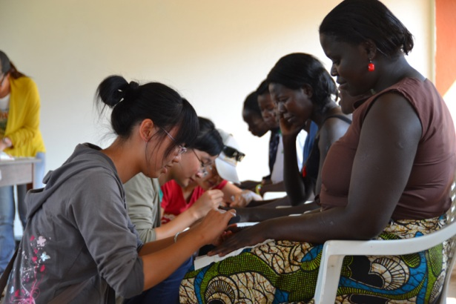
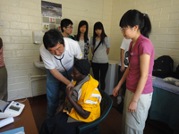
I*CARE

Slide 31
Contemporary China
Studies Programme
NEW
A 4-year full time interdisciplinary undergraduate programme
To be launched: 2013-2014
Jointly offered by
  Faculty of Arts
  Faculty of Social Science

Slide 32
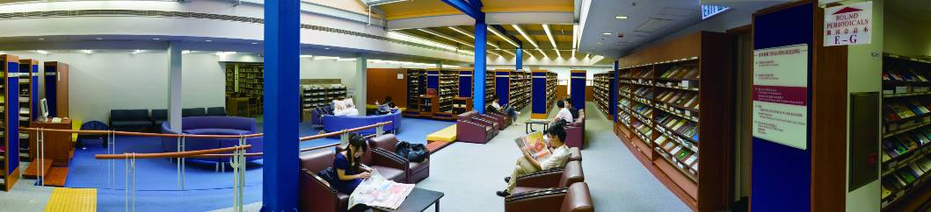
Highlights
It explores China’s politics, economics, society, culture, as well as China’s position in the globalized world
Taught in English, and targets those whose first language is not Chinese; no knowledge of Chinese is required for entry
Students can opt for one of two streams:
Humanities (leading to a Bachelor of Arts degree) ; or
Social Science (leading to a Bachelor of Social Science degree);
With specialisation in one of the four concentrations

Slide 33
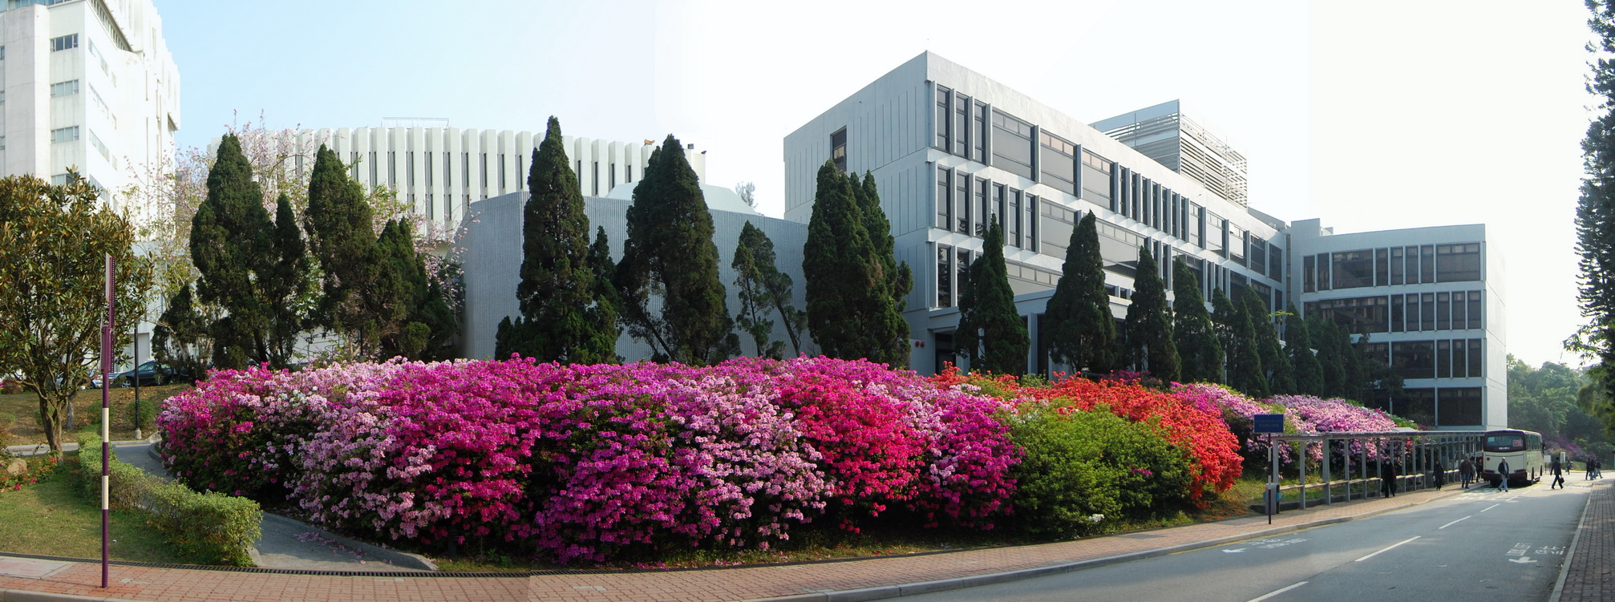
Highlights
Students will study Chinese Language with focus on vocabulary, grammar & oral practice
They will be taking part in a semester-long exchange in an institution in mainland China or Taiwan

Slide 34
Curriculum
Major required courses
Exchange studies
Language courses, GE, etc
Humanities
Stream
Social
Science
Stream
Concentration 1
Humanities
Concentration 2
Language &
Culture
Concentration 3
Development
Concentration 4
Political
Economy
Bachelor of Social Science
Bachelor of Arts

Slide 35
Major Courses
China’s Cultural Past
Chinese Culture and Society
Modern China
Global China
Media China
Fundamentals of Political Economy
Politics in Contemporary China
Economic System and Development in China
Geography of Development in China
Contemporary China: Summer Fieldwork; or
Research Methods in Social Science
Capstone Research Project

Slide 36


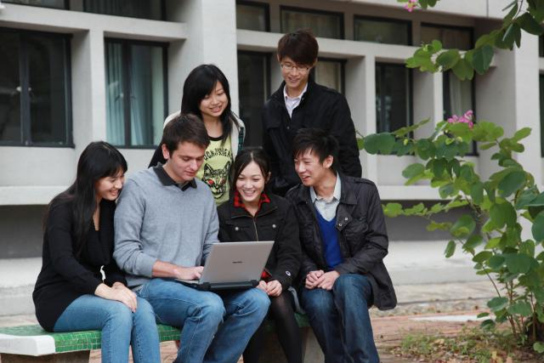
Selected courses of Concentrations
Humanities Stream
Perspectives on Contemporary China
Cultural History of Modern China
China’s Regions and Their Global Interactions
Chinese Practices in Foreign Direct Investments
Social Science Stream
Social Issues and Problems in Contemporary China
Law and Society in China
Financial Markets of Contemporary China
Landscapes of China Business

Slide 37

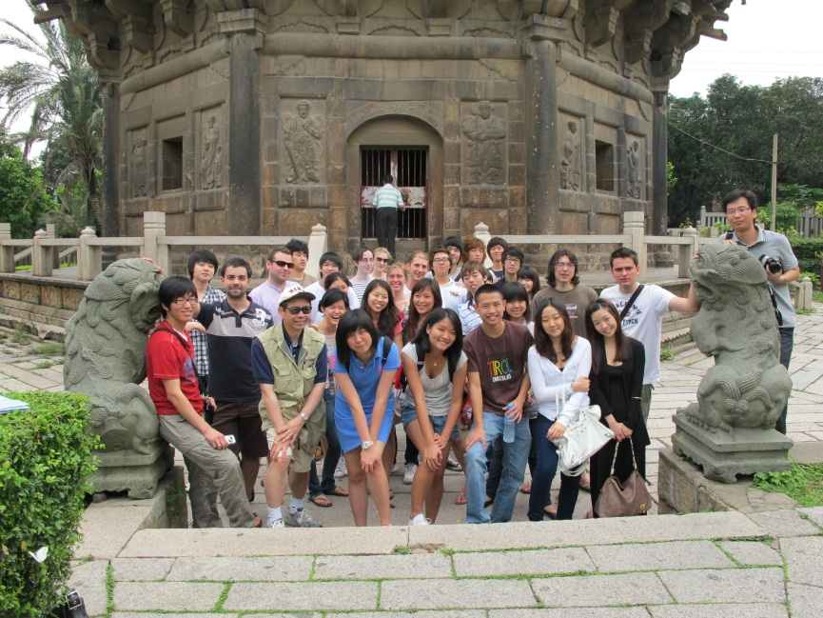
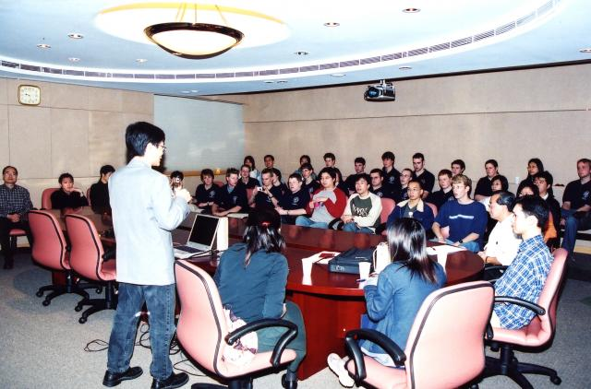
Programme Features
Exchange: Mainland / Taiwan (2nd Term in Yr 2)
Summer Fieldwork

Slide 38
Exchange Students
from other universities
Exchange students are also welcome to take any course from the 3 groups of curriculum of the Programme. Examples are:
Introduction to Contemporary China Studies
China’s Cultural Past
Modern China
Politics in Contemporary China
Fundamentals of Political Economy
Humanities Stream in Contemporary China Studies
Perspectives on Contemporary China
Cultural History of Modern China
China’s Regions and Their Global Interactions
Chinese Practices in Foreign Direct Investments
Social Science Stream in Contemporary China Studies
Social Issues and Problems in Contemporary China
Law and Society in China
Financial Markets of Contemporary China
Landscapes of China Business

Slide 39
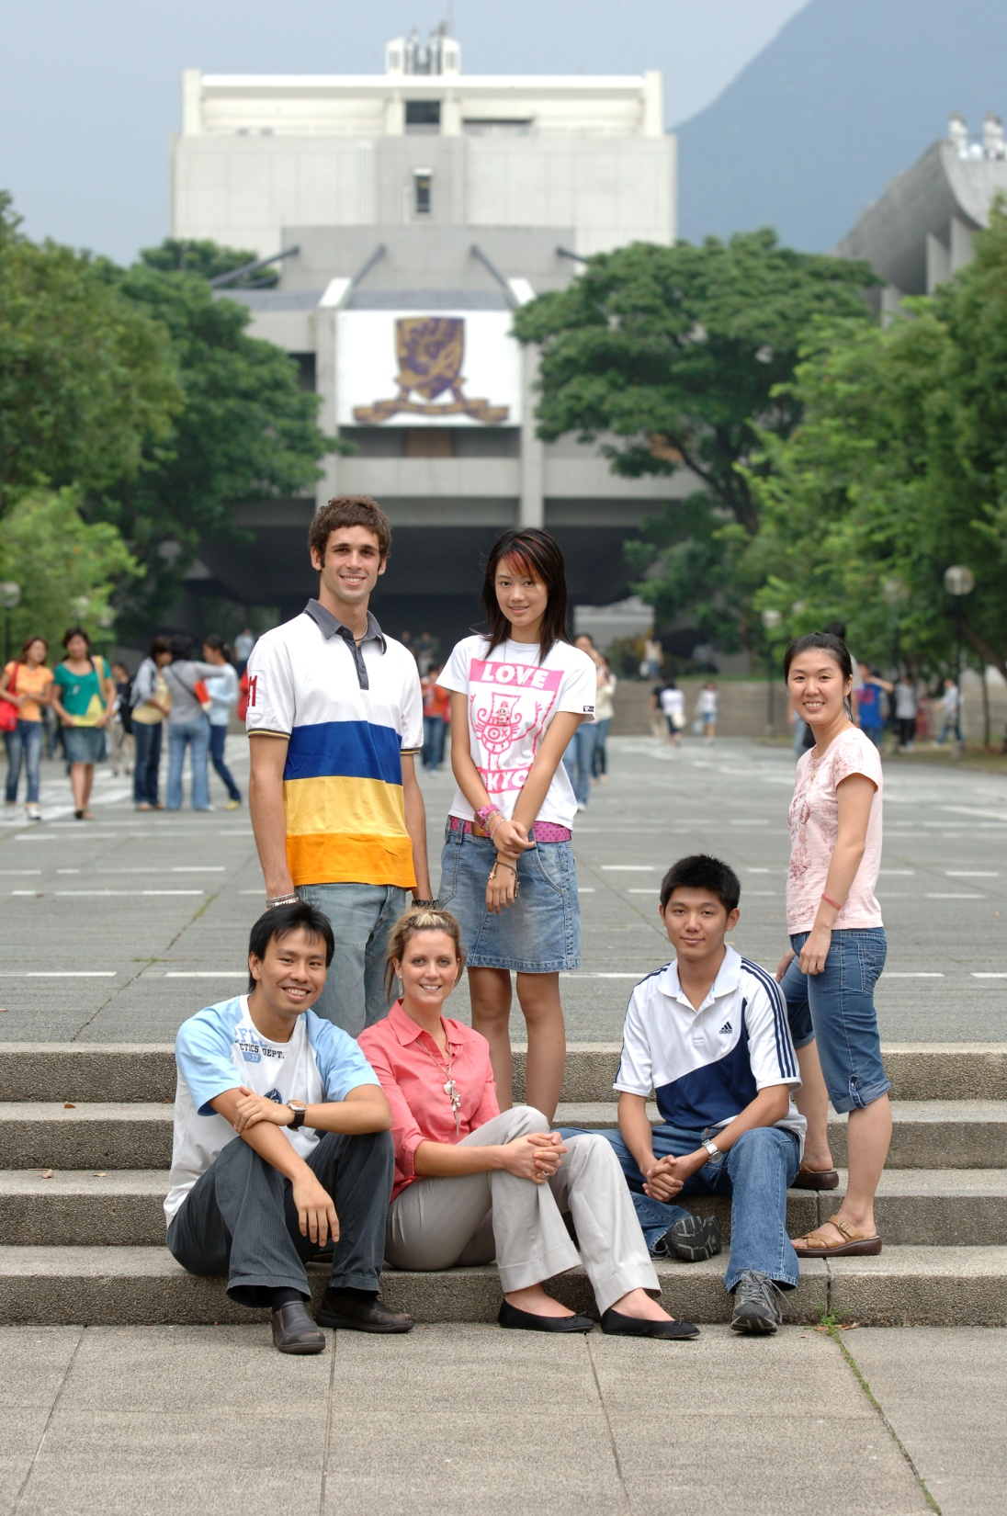
Further information
www.cuhk.edu.hk

Slide 40

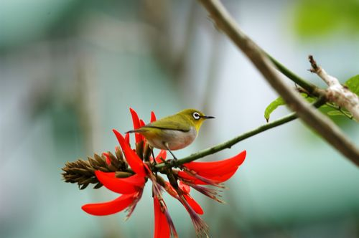
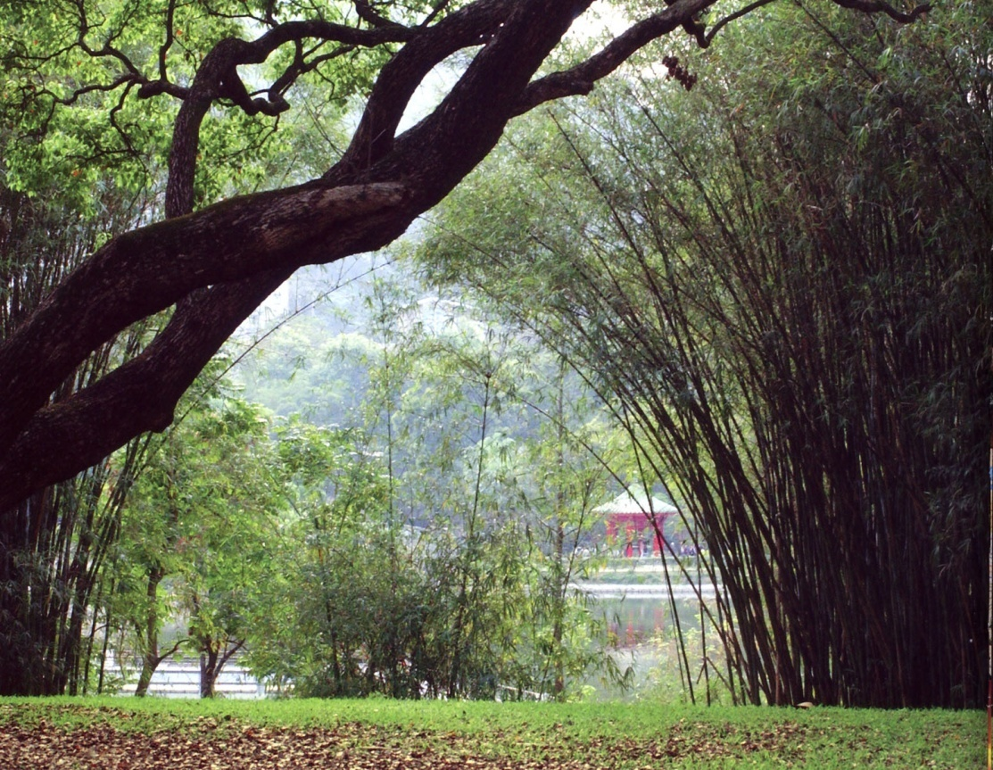

Thank You

