Slide 1
Inbreds, silver-corded, adherents, their scientific productivity and information exchange dynamics: the case of Portugal
Hugo Horta
Center for Innovation, Technology and Policy Research (IN+), Instituto Superior Técnico, Technical University of Lisbon

Slide 2
A quote
“It is natural but not wise for a university to hire its own graduates because breeding in and in has grave dangers for a university”
Charles E. Eliot, President of Harvard University, 1908 on his book on University Administration
Prevalent practice in several countries: Spain, Portugal, France, Russia, Korea, China, Japan, Mexican among others (e.g, Navarro and Rivero, 2001; Yamanoi, 2005; Yimin and Lei 2003).

Slide 3
What is Academic inbreeding?
Practice by which universities hire as academics their doctoral students right after their graduation studies are completed
Implies that academic career was spent continuously at same institution where doctoral degree was obtained (no mobility throughout the career)
Academics that leave the university where they earned the PhD for some years and then are recruited back are not inbred
They are called in the literature “silver corded”
The definition above is the one given by Berelson in 1960

Slide 4
Research on inbreeding: two perspectives
Behavioral (less creative, independent, flexible): Pelz and Andrews, 1966, Horta et al., 2010)
Research productivity (inbreds produces less than others): Soler 2001; Hargens and Farr, 1973; Inanc and Tuncer, 2011; Horta et al., 2010; Sanz-Menéndez and Castro, 2011
Research finds inbreds to be less productive (Soler 2001), less effective and visible (Inanc and Tuncer, 2011),
their lesser productivity is related to the fact that they are inward looking (Horta et al., 2010),
they are strongly socially embedded in their Alma Mater cultures (Horta et al., 2011),
but that take as much time as non-inbreds to progress in the career in some coutries (Sanz-Menéndez and Castro, 2011).

Slide 5
The why’s of this study
Empirically:
the argument that “silver-corded” academics are different than “inbreds”, and more competitive than “non-inbreds” was never empirically validated (Caplow and McGee, 1958).
Dutton’s argument (1980) that faculty that only worked in one university throughout their career after moving from the Alma Mater (coined “adherents”) would have a similar research productivity to inbreds was never tested.

Slide 6
The why’s of this study
Conceptually:
Analitically inbreeding needs to be thought over: Its definition – by Berelson, 1960 - is more than 50 years old and in these decades several changes happened in higher education, science and in academic careers.
The PhD experience is not necessarily a one university experience alone; emergence of joint and dual doctoral programs around the world, it is becoming increasingly common for doctoral students to spend research periods outside the universities where their doctoral degree is based, not only within the country, but also abroad (Kyvik et al. 1999).
The rise of the postdoctoral position (Stephan and Ma, 2005) and its recognition for the academic career (Horta, 2009)

Slide 7
Research Questions
Do “silver corded” academics have dissimilar communication behaviors and research productivity than inbreds and non-inbreds?
Do “Adherent” academics have a similar communication behaviors and research productivity to that of inbreds?
Does it make sense to update/transform Berelson’s definition?

Slide 8
Data source and characteristics
Database composed by 1420 academics of all scientific fields from universities of the Portuguese higher education system (that provide doctoral education)
Includes information on
Demographics
Career mobility
Work experience
Work conditions and satisfaction levels
Academic socialization, including forms of interaction in the context of working activities
Scholarly results/outputs between 2006 and 2008

Slide 9
Taxonomy of academic careers
Career path | During PhD | Path after PhD
Non-inbred | A | B | C | D
Silver Corded | A | B | A
Adherents | A | B
Mobile inbreds | A (E) | A (E)
Pure inbreds | A | A
A – Alma Mater – where the academic did the PHD
B – First academic position at other university (starting as assistant professor)
C, D –Other academic positions at other universities
(E) – Did research at other university during the PhD or did a post-doc elsewhere other than the Alma Mater

Slide 10
Data – Critical Variables
Variable | Obs | Mean
Information Exchange variables
External Research information Exchange | 1420 | -1.05
Scholarly production variables
Articles in international refereed journals | 1364 | 5.28
Articles in national refereed journals | 1342 | 2.40
Explanatory variables
Silver-corded | 1420 | 0.06
Pure_inbred | 1420 | 0.32
Mobile_inbred | 1420 | 0.26
Adherents | 1420 | 0.22
A Negative Binomial Regression with robust standard errors was used to analyze the counting variables while a OLS regression was used to analyze the information exchange variables

Slide 11
Data – Control Variables
Control variables
Age | 1418 | 46.66
Female | 1420 | 0.39
Had funded to perform R&D in the last 3 years | 1420 | 0.73
Participation in R&D projects in the last 3 years | 1420 | 0.90
Holds position at other institution | 1420 | 0.22
Administrative hours per week | 1314 | 2.61
Teaches graduate students only | 1420 | 0.04
Teaches undergraduate students only | 1420 | 0.12
Average number of students taught | 1420 | 193.19
Publications per career year | 1126 | 2.26
Natural sciences | 1420 | 0.35
Engineering | 1420 | 0.19
Agricultural sciences | 1420 | 0.04
Social sciences | 1420 | 0.24
Humanities | 1420 | 0.11
Institutional variables are also used as fixed effects but not included in the table above

Slide 12
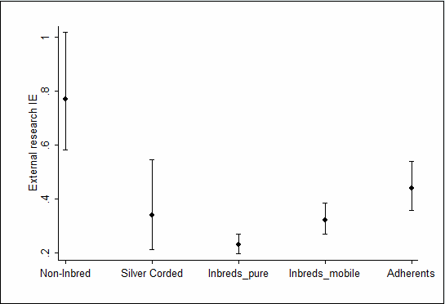
Results: External R&D information exchange
Note: Non-inbred refers to mobile non inbreds (baseline)
Predicted information exchange dynamics for several academic career paths (with 95% confidence intervals)

Slide 13
Main results: research productivity
Inbreds produce 11% fewer articles in international journals, but out-produce non-inbreds in the production of articles in national journals by 23%.
The scientific productivity of silver-corded is undifferentiated from that produced by non-inbreds, but they also out-produce the latter in the production of articles published in national journals by 40%.
Scientific publication specialization occurs between inbreds and non-inbreds; Silver-corded more competitive!

Slide 14
Main results: research productivity
Pure inbreds (extreme immobility) produce 20% fewer articles in international journals than non-inbreds, out-producing the latter only in the production of articles in national journals by 28 %.
Unlike pure inbreds, mobile inbreds have an output in terms of articles published in international journals that is indistinguishable of that of non-inbreds (but still smaller!)
Both adherent and mobile inbreds publish more articles in national journals (adherents 35% more; mobile inbreds 46% more) than mobile non-inbreds – Specialization!
Adherent academics do not produce as many articles in national journals (adherents 35 % more; silver-corded 75 % more) when compared with the baseline of mobile non-inbreds.

Slide 15
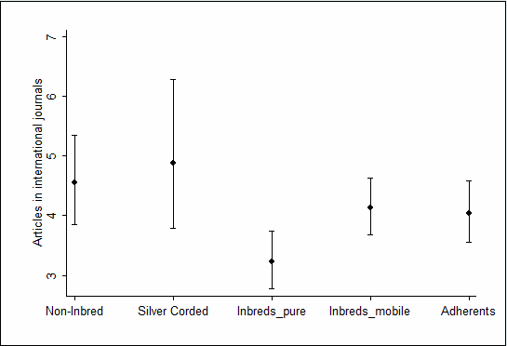
Results: Articles international journals
Note: Non-inbred refers to mobile non inbreds (baseline)
Predicted number of articles published in international journals in the last 3 years for several academic career paths
(with 95% confidence intervals)

Slide 16
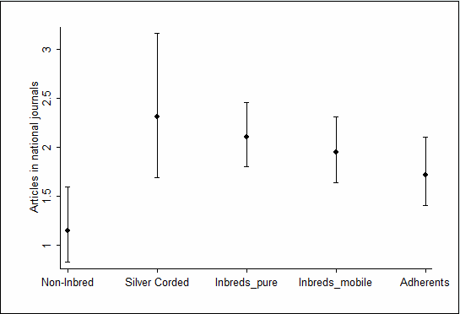
Results: Articles national journals
Note: Non-inbred refers to mobile non inbreds (baseline)
Predicted number of articles published in national journals in the last 3 years for several academic career paths
(with 95% confidence intervals)

Slide 17
Contributions of this study
“Silver-corded" academics cannot be considered inbreds and can be considered as competitive academics in terms of research productivity;
“Adherent" academics (those who moved only once from the university where they concluded their PhD to the university where they are currently working) have information exchange behaviors and scientific productivity that are closer to the ones of mobile inbreds rather than to non-inbreds, thus validating Dutton’s (1980) concerns;
Results of pure/mobile inbreds underlines the need for a new conceptual understanding of academic inbreeding, which takes into consideration the changes in science and higher education in the last 60 years. But in general the same “sympthons” are there for both and the key is that:
MOBILITY IN THE ACADEMIC CAREER MATTERS

Slide 18
Thank you! спасибо!
Details on these results can be found at:
Horta, H., “Deepening our understanding of academic inbreeding effects on research information exchange and scientific output: new insights for academic based research” (Accepted at Higher Education; 2012)
http://www.springerlink.com/content/1j026734243844r8/

