Slide 1
III International Conference of the Russian Association of Higher Education Researchers “The Birth and Revival of Universities”
Institutional Change, Leadership and Strategic Planning: The Case Study of Pratt Institute
Vladimir Briller, Ed.D., Executive Director of Strategic Planning and Institutional Research,
Pratt Institute, New York, U.S.A.

Slide 2
Introduction
Pratt

Slide 3
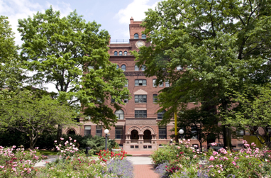
Pratt Institute
Pratt Institute is a private art college located in Brooklyn, New York, with satellite campuses in Manhattan and Utica. Pratt offers degrees in Architecture; Interior, Industrial, Communications, Fashion and other design programs; Fine Arts; Digital Arts; Creative Writing; Library and Information Science, and other areas.

Slide 4
History
The Institute opened on October 17, 1887 with a drawing class of 12 students, and quickly expanded its course offerings, attracting more than 1,000 students by fall 1888.
Reflecting Charles Pratt’s concern with the welfare of the general public, the Institute’s library, which opened in January 1888, served as Brooklyn’s first free public library.

Slide 5
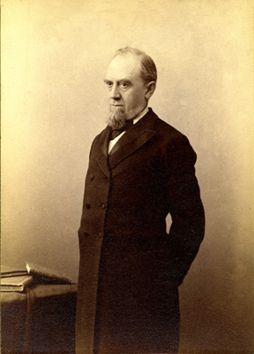
Charles Pratt
From the first day of classes in October 1887 to the opening of Myrtle Hall in December 2011, Pratt Institute has offered students and faculty members the opportunity to make a tangible difference on a local, national, and international scale. While the Institute's curriculum and scope have evolved in the decades since its founding, its programs remain true to the founder's vision, “Be true to your work and your work will be true to you.”

Slide 6
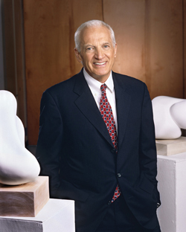
Thomas F. Schutte
When President Thomas F. Schutte took office, he articulated a vision for the institution that emphasized one dominant principle: quality. To reach the goal of total quality, an ambitious strategy had to be set forth and numerous fronts tackled at once - improving educational programs, increasing enrollment while maintaining selectivity, building relationships within the community surrounding Pratt, and renovating and improving Pratt campus and its many landmark buildings.

Slide 7
1993-2012 comparisons
 | 1993 | 2012
Enrollment | 2,400 | 4,700
Finance | Debt: $14.5 mln | Endowment: $102 mln
Budget | $48 mln | $200 mln
National Ranking (A&D) | n/a | 1-2
Faculty | 507 | 1,055

Slide 8
Dime Bank’s Condition of Help
Pratt had to retain a planning consultant from the Dime’s accounting firm, Coopers and Lybrand to develop and implement a strategic plan for the next five years. Thus began now institutionalized five-year strategic planning commitment and program.
Pratt has successfully implemented three five-year strategic plans:
1996 – 2000
2001 – 2005
2006 – 2011

Slide 9
Tough Strategic Decisions
1993 – closing School of Engineering
1994 – changing from local into national school
1994/1995 – selling property
1999 and 2011 – voluntary salary freezes for non-unionized employees
2011 – hiring freeze
Minimizing administrative staff

Slide 10
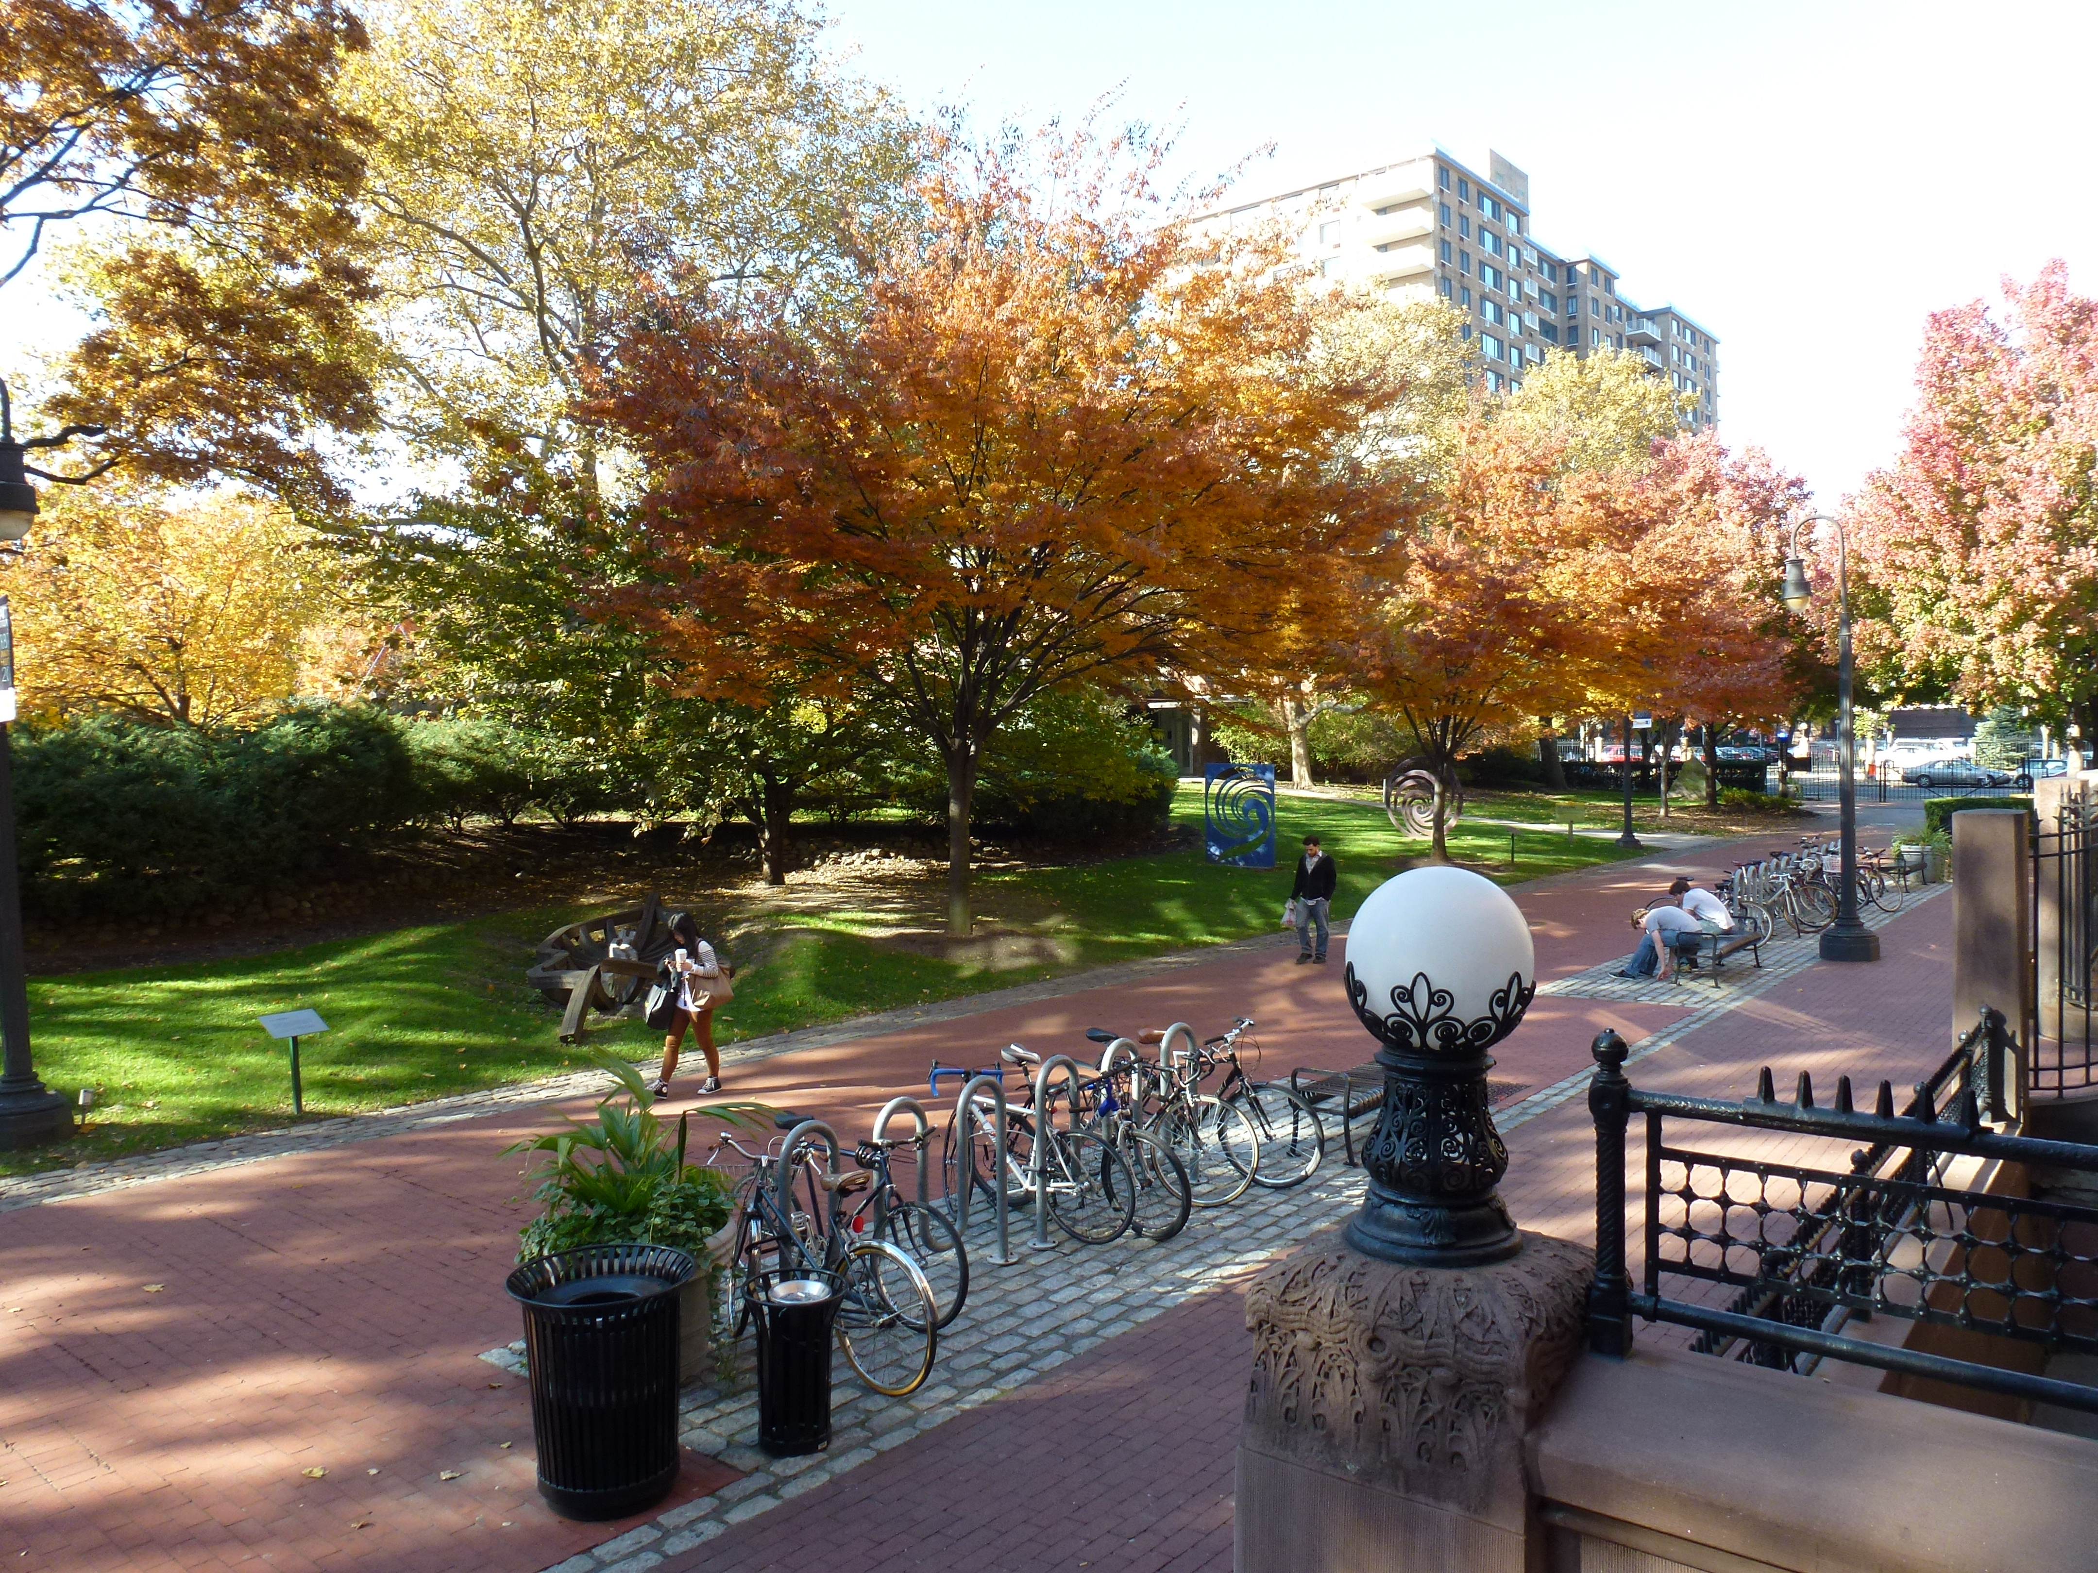
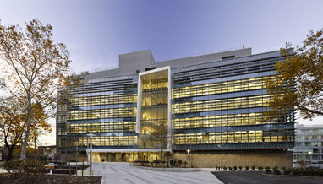
Select Strategic Decisions
Focus on campus and facilities
Buy land and property

Slide 11

Select Strategic Decisions
Full-time/part-time faculty ratio
Invest in the programs with the greatest potential – example – Fashion Design

Slide 12
Developing 2012-2017 Strategic Plan
Complete institutional transparency;
An expanded and representational planning committee;
A professional administrative planning director;
An outside professional planning consulting group;
Engaged and expanded group of administrators, staff, and faculty throughout the Institution (more than 1000 hours of discussions and roundtables with students, faculty, staff, administrators, Board of Trustees and community).

Slide 13
Thank you for your time,
QUESTIONS?

